Slide 1
Pharmaceutical Needs Assessment:
Purbeck
PNA Locality Profile
March 2025

Slide 2
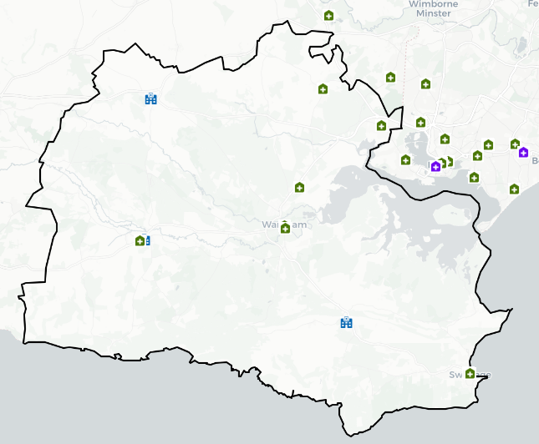
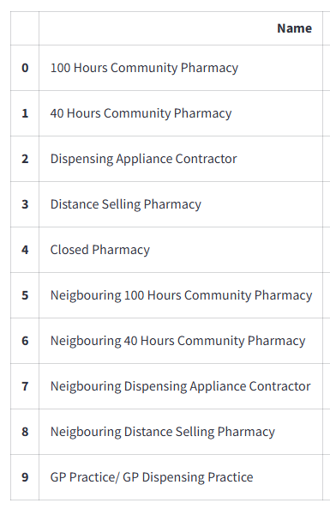

Introduction
Purbeck PNA locality has no gaps and is in Dorset Council. It is largely rural with a higher proportion of older people compared to the national average. The PNA locality has low levels of deprivation with no areas amongst the worst 20% deprived in England. Housing growth will be seen in Lytchett Matravers, Bere Regis and Wool, provided these developments are completed.
An analysis of health and the wider determinants of health highlights poor outcomes for emergency hospital admissions for stroke, incidence of all cancer, prostate cancer, heart attack and hospital admissions for self-harm.
There are currently 9 pharmacies and three dispensing practices within the locality as of January 2025. The following headings have been used to describe the PNA locality in more detail:
Number of pharmacies, openings hours & services
Demographics & Deprivation
Housing
Health and Wider Determinants

Slide 3
Number of Pharmacies
As of January 2025, there are nine pharmacies in Purbeck PNA locality. There are three practices with dispensing doctors providing drugs and appliances to their own patients.
Of the nine pharmacies, there are:
Nine providing Pharmacy First services.
Three independent pharmacies.
Six pharmacies owned by national pharmacy chains:
  Two by Boots Pharmacy
  Two by Well Pharmacy
  One by Day Lewis Pharmacy
  One by Rowlands Pharmacy
Nine pharmacies with 40-hour contracts and no pharmacies with 72-hour contracts.
No distance-selling pharmacies
No pharmacies with local pharmaceutical services contracts
No dispensing appliance contractors (DAC).

Slide 4
Number of Pharmacies
The table below shows the provision in Purbeck PNA Locality since the last PNA was published. There is no national expectation or standard on the ratio of pharmacies to population. These ratios do not consider the size and staffing of pharmacies which will determine the size of the population they are able to serve.
Number and rate of pharmacies and items dispensed in Purbeck PNA Locality, 2021/22 - 2024/25 (8 months).
Financial Year | Area | Population | Number of pharmacies in latest month of FY | Pharmacies per 100,000 population | Number of dispensed items | Items dispensed per head
2021/22 | Locality | 45,893 | 9 | 19.6 | 754,442 | 16.4
2022/23 | Locality | 45,866 | 9 | 19.6 | 776,602 | 16.9
2023/24 | Locality | 45,866 | 9 | 19.6 | 804,655 | 17.5
2024/25 (8 months) | Locality | - | 9 | - | 530,967 | -
2023/24 | Dorset | 384,809 | 68 | 17.7 | 7,227,720 | 18.8
2023/24 | South West | 5,811,259 | 1,107 | 19.0 | 99,164,702 | 17.1
2023/24 | England | 57,690,323 | 12,009 | 20.8 | 1,112,920,890 | 19.3
Source: NHS Business Services Authority
Notes: Populations for locality and local authority are based on ONS mid-year population estimates. The population for each financial year is taken as the mid-year estimate for the first of the two years that make up the financial year. For example, for 2021/22 the population is taken as the mid-year estimate for 2021. If that year is not yet available, the latest available year is used.

Slide 5
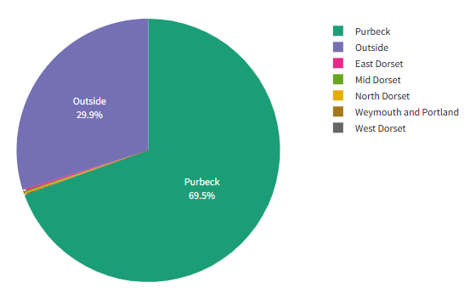
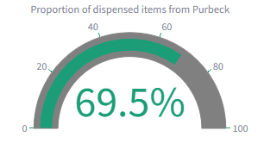
Number of Items Dispensed
The total number of items dispensed in this locality so far in 2024/25 is 530,967. Of the total number of items dispensed in this locality, 70% were prescriptions from GPs located in the same locality.

Slide 6
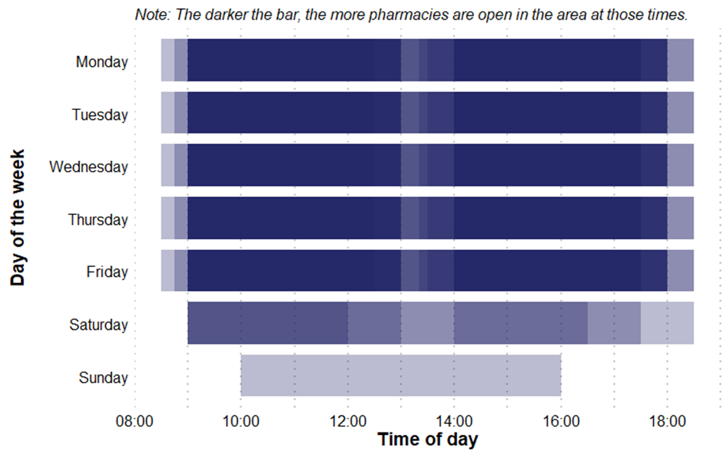
Pharmacy Opening Times
Purbeck PNA Locality pharmacy coverage across the week, January 2025
Access to the essential services (core plus supplementary opening hours)
As of January 2025, in Purbeck PNA locality, there are:
One pharmacy open seven days a week
Three pharmacies open six days a week
Five pharmacies open five days a week
No pharmacies open before 8:00 at least five days a week
No pharmacies open past 18:30 at least five days a week

Slide 7
Provision of Services
Below is a summary of the provision of advanced and enhanced services in Purbeck PNA locality as of January 2025.
New Medicine Service (NMS) accreditation: 9 pharmacies. In 2023/24 (the last full year of data), there were 4,659 NMSs undertaken.
Specialist Medicines Provider: No pharmacies.
Influenza vaccination: Eight pharmacies providing this advanced service.
Appliance Use Reviews: No pharmacies providing this service. Many appliances will be dispensed by DACs based around the country, which may provide this service.
NHS Pharmacy contraception: Seven pharmacies providing this service.
Lateral Flow Device test supply: Eight pharmacies providing this service.
Hypertension Case-Finding: Nine pharmacies providing this service.
Stop Smoking: Nine pharmacies providing this service.
.

Slide 8
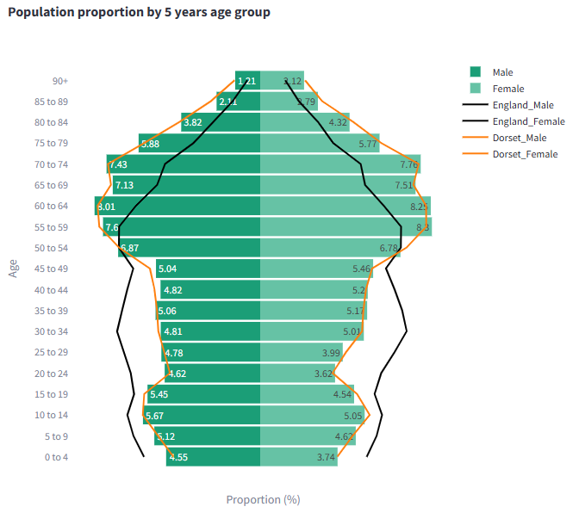
Demographics
Mid year resident population data show that there are approximately 45,900 people resident in the Purbeck PNA Locality (22,500 males and 23,400 females).
51% of its residents are female, 49% are male. 30% are 65 years and older.
Purbeck PNA Locality has a similar population structure to the Dorset Council average. Compared to the national average it has a lower proportion of people aged under 18 and of working age but a higher proportion of people aged 65 & over.
Source: Mid Year Population Estimates 2022

Slide 9
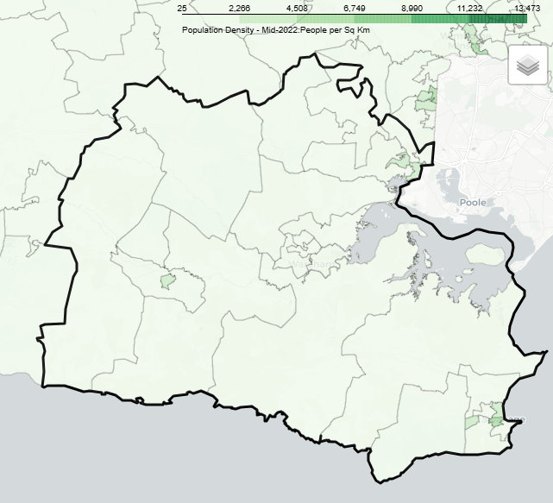
Demographics
The area covered by the Purbeck PNA Locality is largely rural with the highest population density around the towns of Upton, Swanage and Wool.
Over the next 3 years from 2025-28 population projections suggest the population of Dorset overall will increase by 4,300 (1.1%). This growth is driven by increases in the population aged over 65, with the number of children and young people (aged 0-16), and working age population projected to decrease.
The number of over 65s are projected to increase by almost 8,200 thousand (7%) to 2028, compared to a decrease of around 1,900 (-3%) for children and young people aged 0-16. The working age population is forecasts to decline by just under 2,000 (-1%). By 2025 those aged 65+ will account for a third of the overall population.

Slide 10
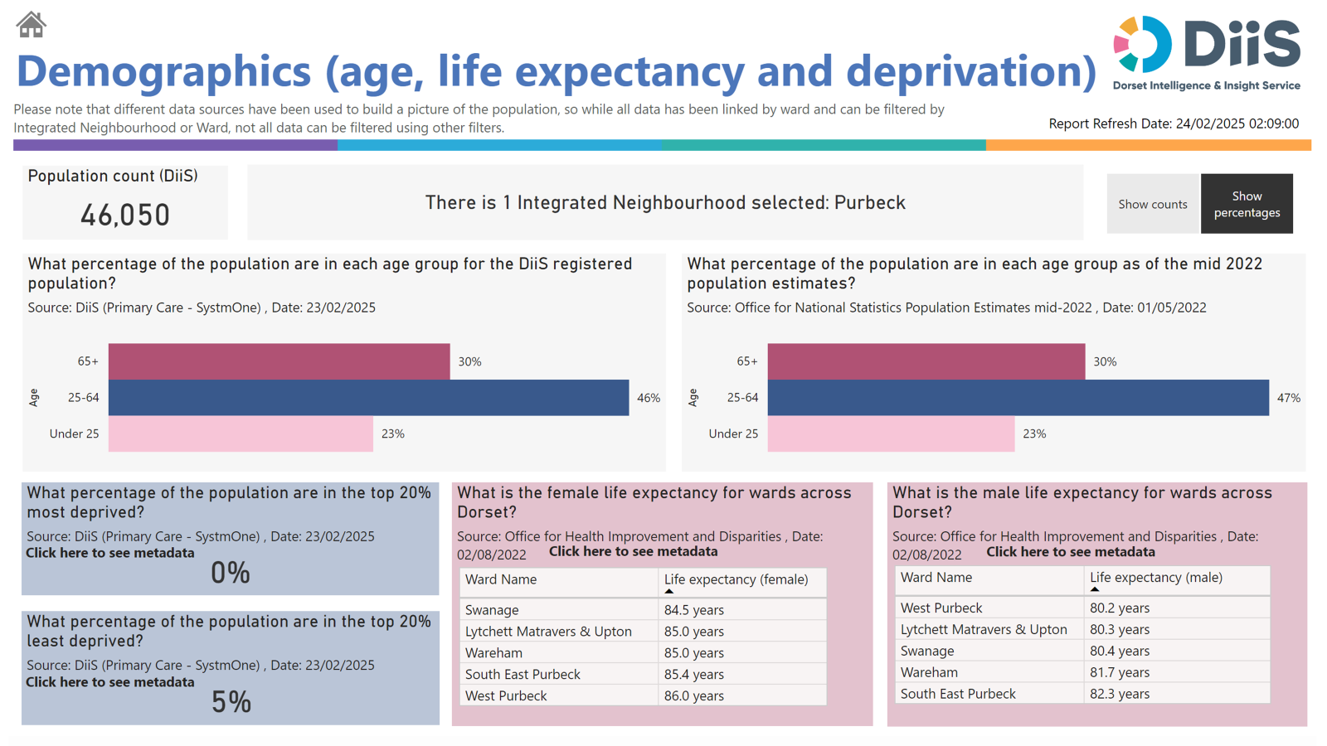
Demographics

Slide 11
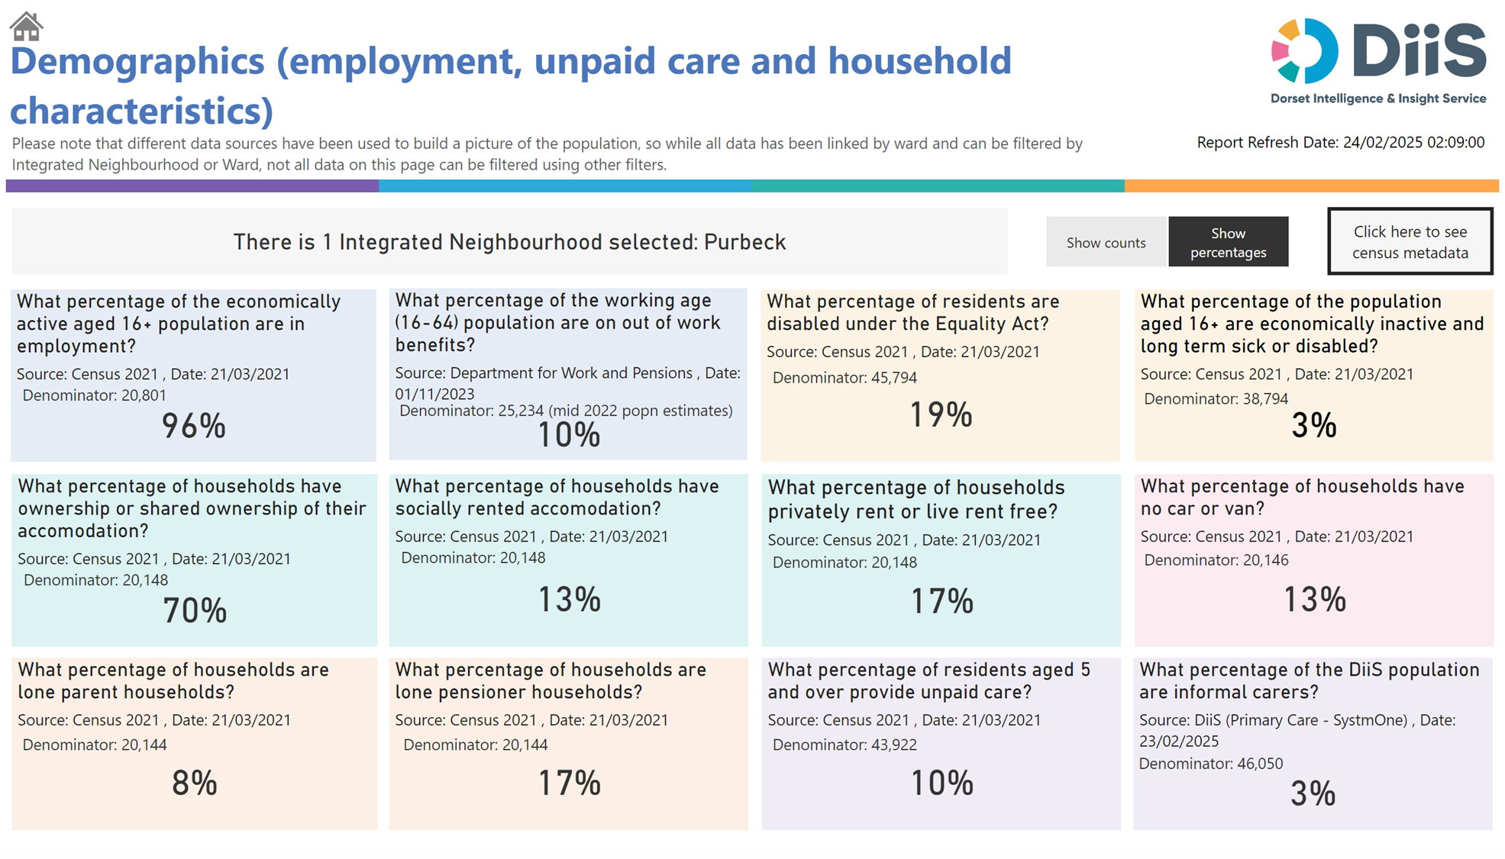
Demographics

Slide 12
Housing
To understand any increases in demand for services based on planned housing developments, planning applications with consent to build to 2029 in BCP and Dorset have been analysed. Postcodes (or the nearest existing postcode to the development site) have been matched to Wards and then to PNA Locality.
This gives a realistic picture of housing growth within the Neighbourhood. The net level of development for this PNA Locality is approximately 630 dwellings. This is about 7% of the total net housing development for Dorset Council.
Development is generally across the PCN area; however, some notable areas are Lytchett Matravers & Upton (249), West Purbeck (160) around Bere Regis and Wool, South East Purbeck (90) and Swanage (79).

Slide 13
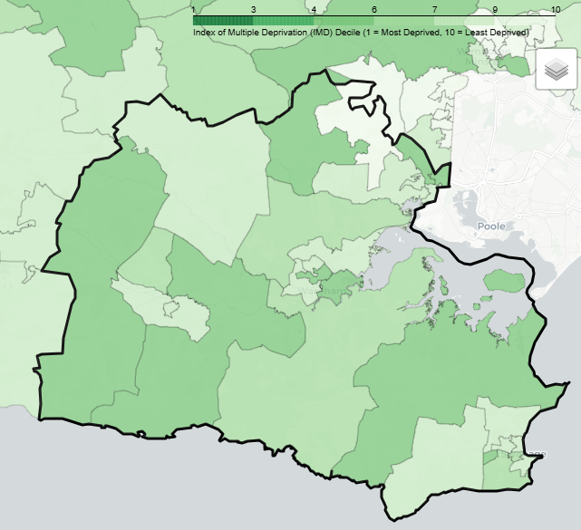
Deprivation
There are no lower super output areas (LSOAs) in Purbeck PNA Locality that are in the most deprived national quintile.
Two LSOAs are among the most 40% deprived.
9% of its population live in the 20% most deprived areas of Dorset.
None of its residents live in the 20% most deprived areas of England.

Slide 14
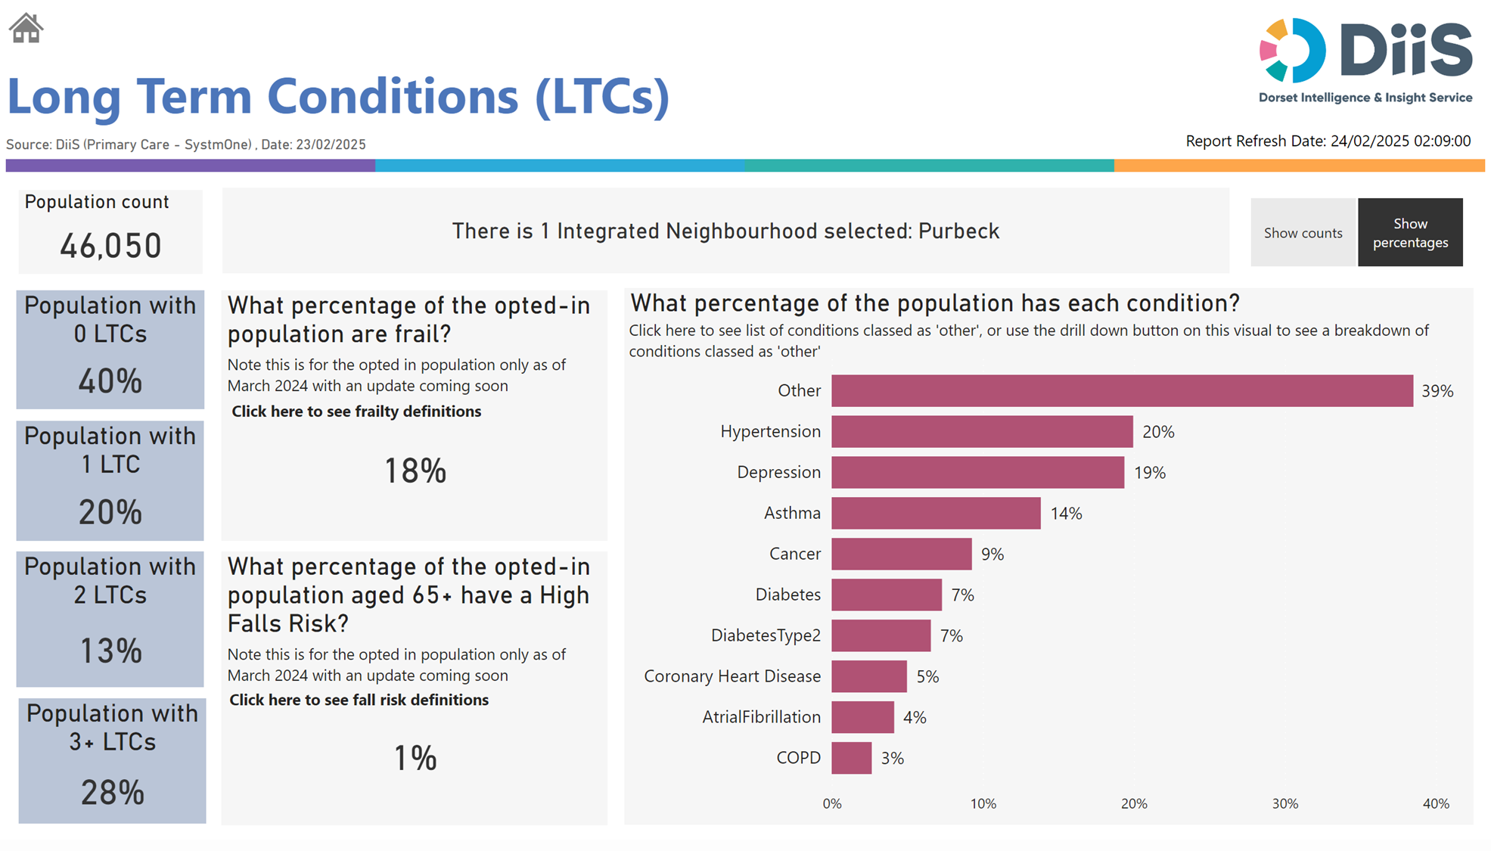
Health and Wider Determinants

Slide 15
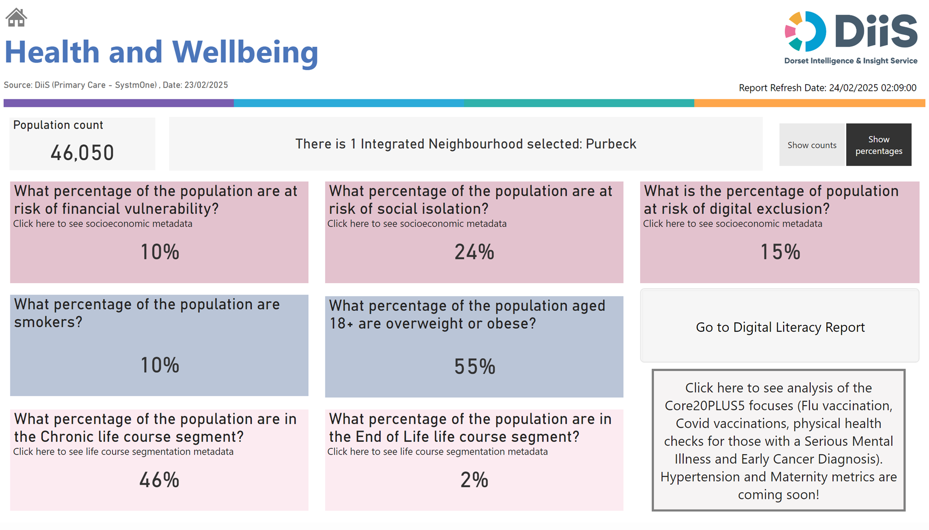
Health and Wider Determinants

Slide 16
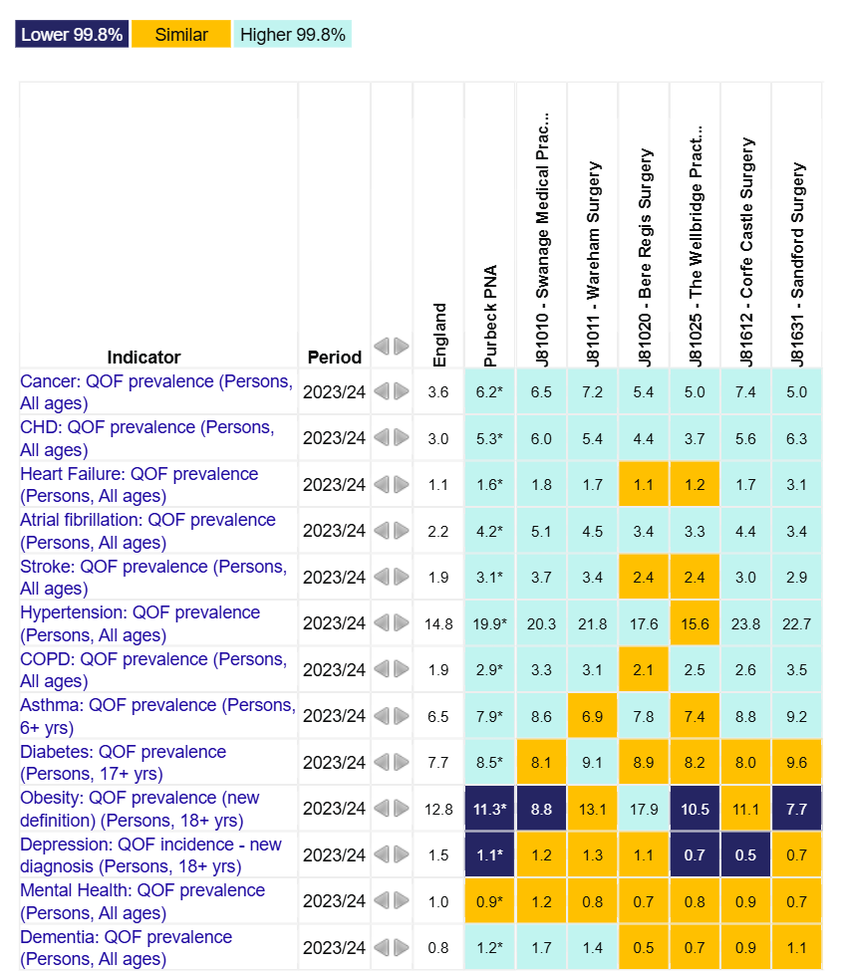
Health and Wider Determinants
To understand the health needs and wider determinants of health in the PNA Locality, a national profiling tool has been used. This compares local level data with the English average and highlights any areas that are significantly different.
The overview chart visualises the data and for each indicator it highlights whether the value is lower or higher to national rates using a 99.8% confidence interval.

Slide 17
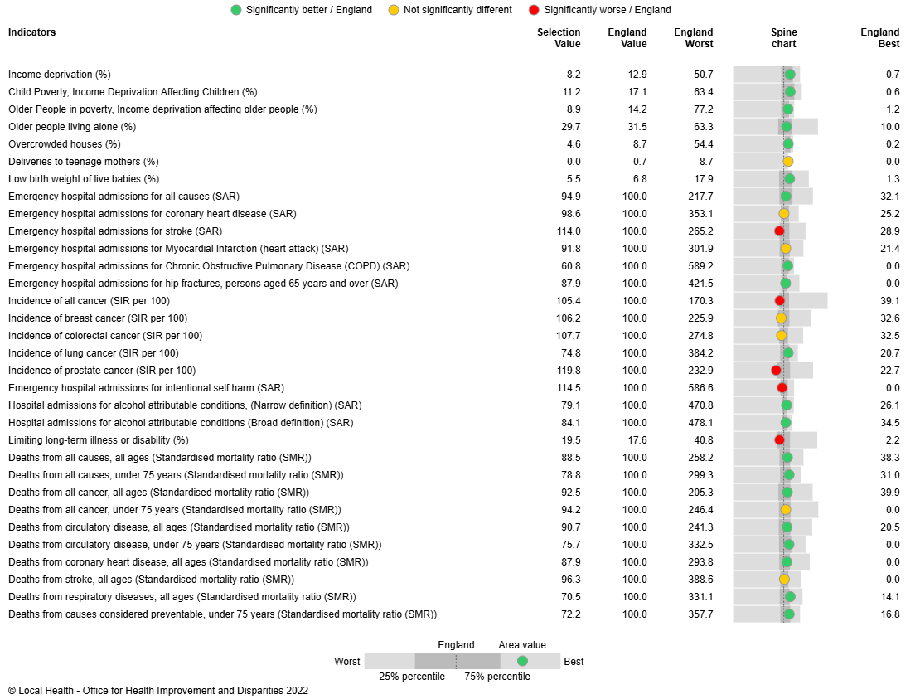
Health and Wider Determinants
Local Health provides evidence of inequalities within local areas aggregated to represent this PNA Locality.
The spine chart below visualises the data and for each indicator it highlights whether the value is significantly different to national rates using a 95% confidence interval.

