Slide 1
Pharmaceutical Needs Assessment: Poole PNA Locality Profile
March 2025

Slide 2
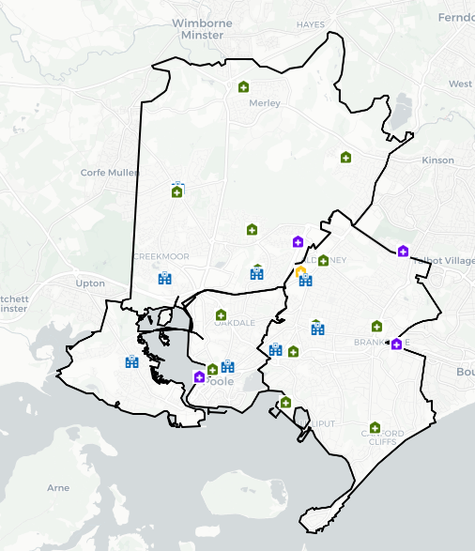
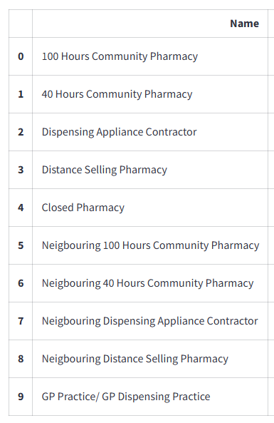
Introduction
Poole PNA Locality Area is within BCP Council. It is largely urban with a higher proportion of older people compared to the BCP average. The Neighbourhood Area is relatively less deprived compared to both local and national levels but has pockets of high deprivation.
Notable housing growth will mainly be seen in Poole around Canford & Creekmoor and in the town centre.
An analysis of health and the wider determinants of health highlights poor outcomes for hospital admissions for coronary heart disease, stroke, heart attack, hip fractures, hospital admissions for self-harm, alcohol conditions.
There are currently 25 pharmacies within the locality as of January 2025. The following headings have been used to describe the PNA locality in more detail:
Number of pharmacies, openings hours & services
Demographics & Deprivation
Housing
Health and Wider Determinants

Slide 3
Number of Pharmacies
Of the 25 pharmacies, there are:
24 providing Pharmacy First services.
13 independent pharmacies.
12 pharmacies owned by national pharmacy chains:
Four by Rowlands Pharmacy
Three by Boots Pharmacy
Two by Day Lewis Pharmacy
One by Asda Pharmacy
One by Avicenna Pharmacy
One by Jhoots Pharmacy
21 pharmacies with 40-hour contracts and four pharmacies with 72-hour contracts.
One distance-selling pharmacy
No pharmacies with local pharmaceutical services contracts
No dispensing appliance contractors (DAC).

Slide 4
Number of Pharmacies
The table below shows the provision in Poole PNA Locality since the last PNA was published. There is no national expectation or standard on the ratio of pharmacies to population. These ratios do not consider the size and staffing of pharmacies which will determine the size of the population they are able to serve.
Number and rate of pharmacies and items dispensed in Poole PNA Locality, 2021/22 - 2024/25 (8 months).
Financial Year | Area | Population | Number of pharmacies in latest month of FY | Pharmacies per 100,000 population | Number of dispensed items | Items dispensed per head
2021/22 | Locality | 157,195 | 29 | 18.4 | 2,578,070 | 16.4
2022/23 | Locality | 157,190 | 29 | 18.4 | 2,659,860 | 16.9
2023/24 | Locality | 157,190 | 27 | 17.2 | 2,674,093 | 17.0
2024/25 (8 months) | Locality | - | 26 | - | 1,780,054 | -
2023/24 | Bournemouth, Christchurch and Poole | - | 73 | - | 6,978,169 | -
2023/24 | South West | 5,811,259 | 1,107 | 19.0 | 99,164,702 | 17.1
2023/24 | England | 57,690,323 | 12,009 | 20.8 | 1,112,920,890 | 19.3
Source: NHS Business Services Authority
Notes: Populations for locality and local authority are based on ONS mid-year population estimates. The population for each financial year is taken as the mid-year estimate for the first of the two years that make up the financial year. For example, for 2021/22 the population is taken as the mid-year estimate for 2021. If that year is not yet available, the latest available year is used.

Slide 5
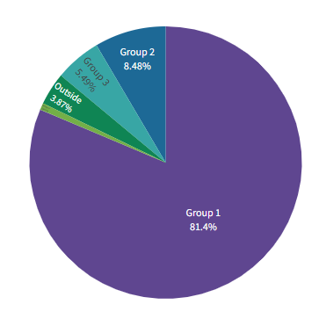
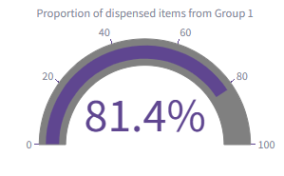
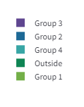
Number of Items Dispensed
The total number of items dispensed in this locality so far in 2024/25 is 1,780,000. Of the total number of items dispensed in this locality, 81% were prescriptions from GPs located in the same locality.

Slide 6
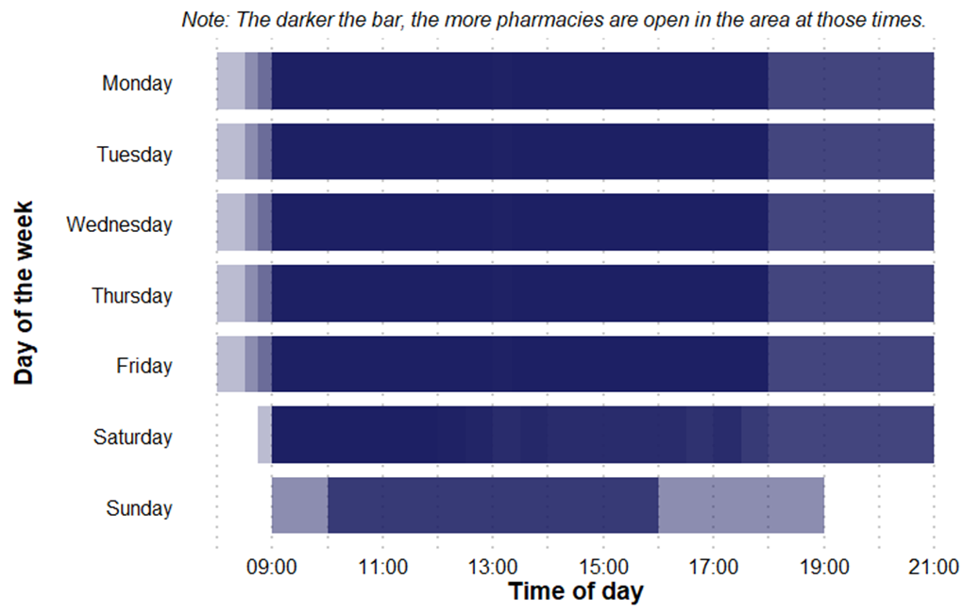
Pharmacy Opening Times
Poole PNA Locality pharmacy coverage across the week, January 2025
Access to the essential services (core plus supplementary opening hours)
As of January 2025, in Poole PNA locality, there are:
Five pharmacies open seven days a week
14 pharmacies open six days a week
Six pharmacies open five days a week
No pharmacies open before 8:00 at least five days a week
Four pharmacies open past 18:30 at least five days a week

Slide 7
Provision of Services
Below is a summary of the provision of advanced and enhanced services in this locality as of January 2025.
New Medicine Service (NMS) accreditation: 25 pharmacies.
Specialist Medicines Provider: No pharmacies providing this service
Influenza vaccination: 21 pharmacies providing this advanced service.
Stoma appliance customisation: 4 pharmacies providing this service.
Appliance Use Reviews: 1 pharmacy provides this service. Many appliances will be dispensed by DACs based around the country, which may provide this service.
NHS Pharmacy contraception: 20 pharmacies providing this service.
Lateral Flow Device test supply: 19 pharmacies providing this service.
Hypertension Case-Finding: 22 pharmacies providing this service.
Stop Smoking: 25 pharmacies providing this service.

Slide 8
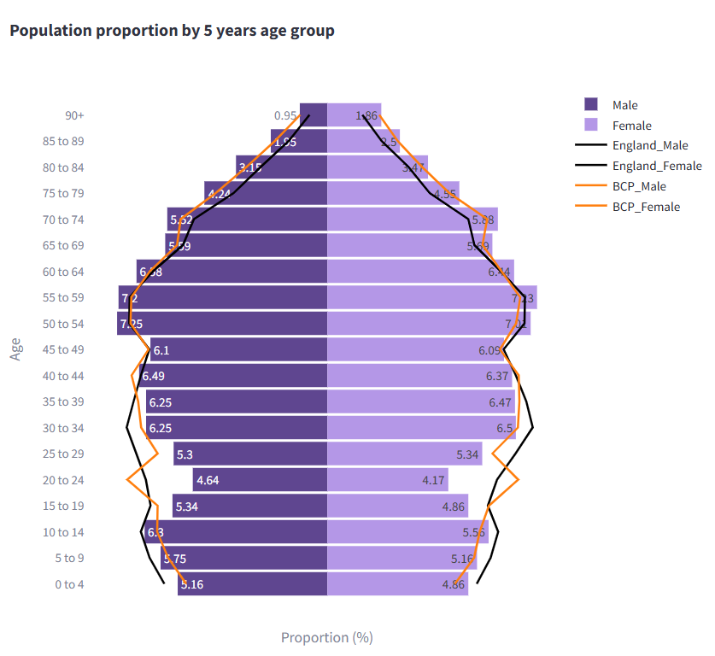
Demographics
Mid year resident population data show that there are approximately 152,800 people resident in the Poole PNA Locality (74,300 males and 78,600 females).
51% of its residents are female, 49% are male. 23% are 65 years and older.
Compared to the BCP average, it has a lower proportion of people aged 15-39 and a higher proportion of people aged 50 & over.
Source: Mid Year Population Estimates 2022

Slide 9
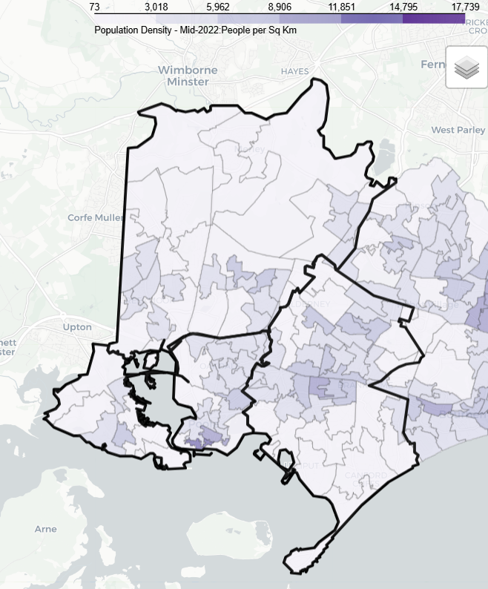
Demographics
The area covered by Poole PNA Locality is largely urban with the highest population density around Poole Town Centre, Parkstone, Canford Heath and Hamworthy
Over the next 3 years from 2025-28 projections suggest the population of the BCP area overall will increase by 2.6 thousand (0.7%).
This growth is driven by increases in the population aged over 65, with the number of children and young people (aged 0-16) projected to decrease.
The number of over 65s is projected to increase by almost 5.2 thousand (6%) to 2025, compared to a decrease of around 2.6 thousand of children and young people. The working age population is forecast to remain roughly unchanged. By 2025 those aged 65+ will account for 24% of the overall population.

Slide 10
Demographics

Slide 11
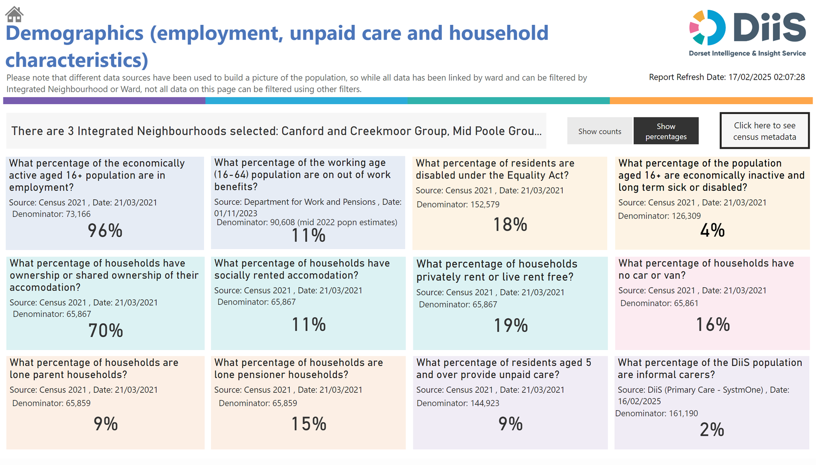
Demographics

Slide 12
Housing
To understand any increases in demand for services based on planned housing developments, planning applications with consent to build to 2029 in BCP and Dorset have been analysed. Postcodes (or the nearest existing postcode to the development site) have been matched to Wards and then to PNA Locality.
This gives a realistic picture of housing growth within the Neighbourhood. The net level of development for this PNA Locality is approximately 3,779 dwellings. This is about 48% of the total net housing development for BCP.
The main areas of proposed development in the PNA locality are predominantly Canford & Creekmoor around Oakley Lane, Magna Road and Knighton Land as well as Poole Town Centre North.

Slide 13
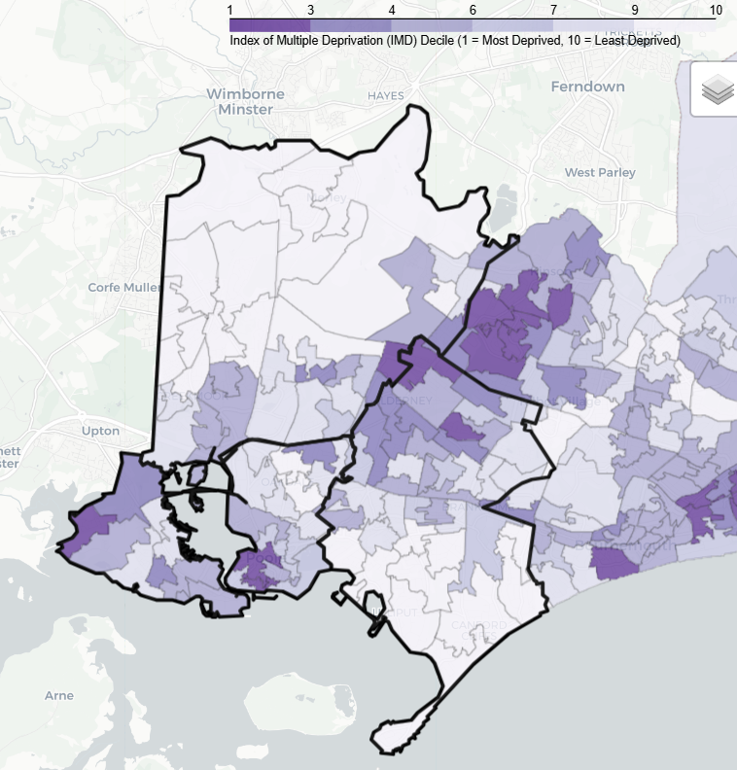
Deprivation
There are five lower super output areas (LSOAs) in Poole PNA Locality that are in the most deprived national quintile.
A further 18 LSOAs are among the most 40% deprived.
17.6% of its population live in the 20% most deprived areas of Bournemouth, Christchurch and Poole.
4.5% live in the 20% most deprived areas of England.

Slide 14
Health and Wider Determinants

Slide 15
Health and Wider Determinants

Slide 16
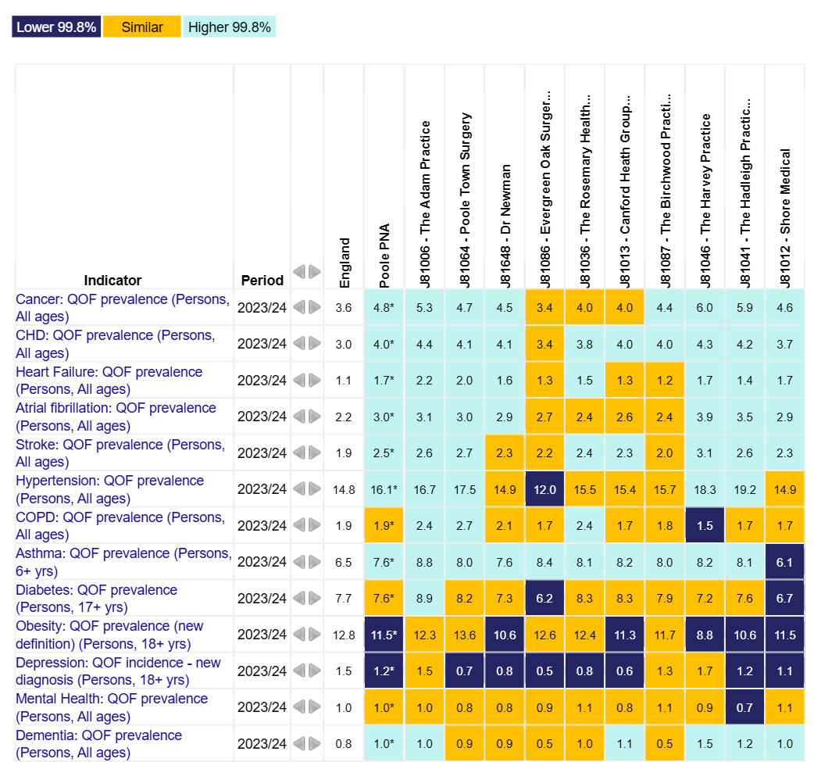
Health and Wider Determinants
To understand the health needs and wider determinants of health in the PNA Locality, a national profiling tool has been used. This compares local level data with the English average and highlights any areas that are significantly different.
The overview chart visualises the data and for each indicator it highlights whether the value is lower or higher to national rates using a 99.8% confidence interval.

Slide 17
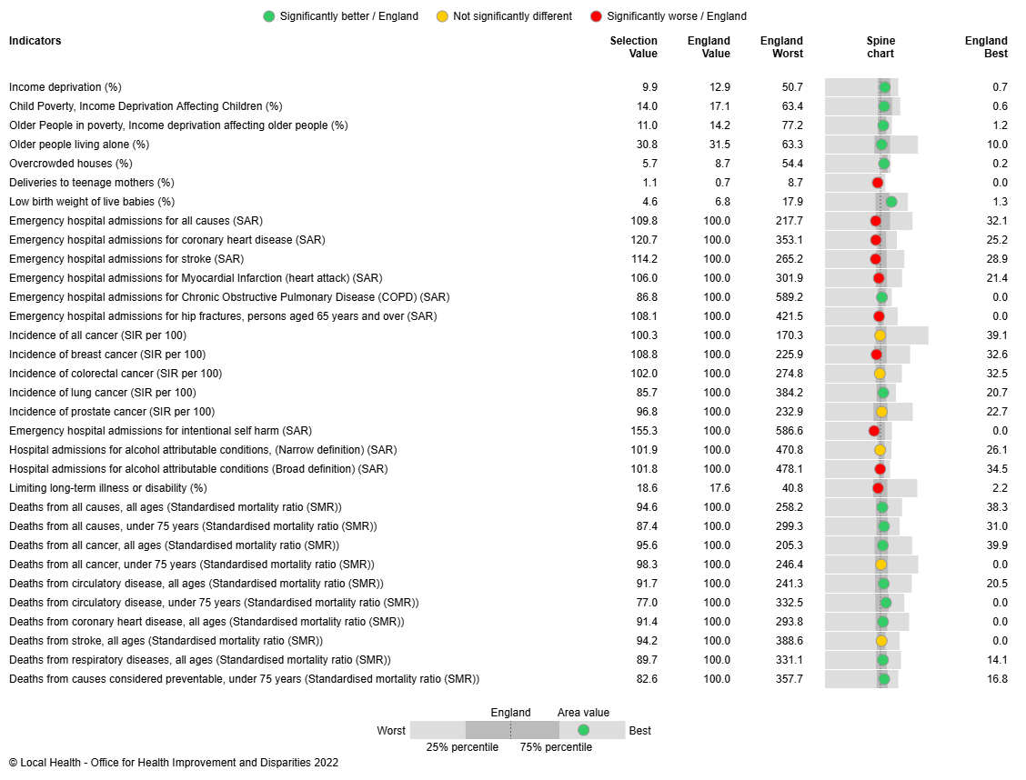
Health and Wider Determinants
Local Health provides evidence of inequalities within local areas aggregated to represent this PNA Locality.
The spine chart below visualises the data and for each indicator it highlights whether the value is significantly different to national rates using a 95% confidence interval.

