Slide 1
Pharmaceutical Needs Assessment: Dorset East PNA Locality Profile
March 2025

Slide 2
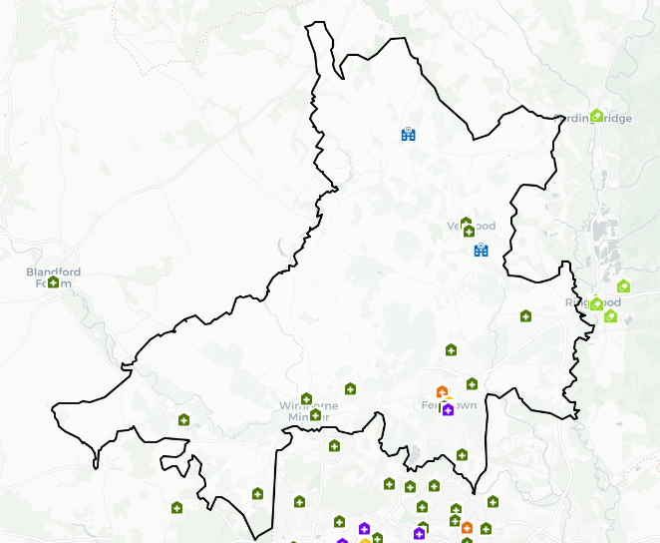
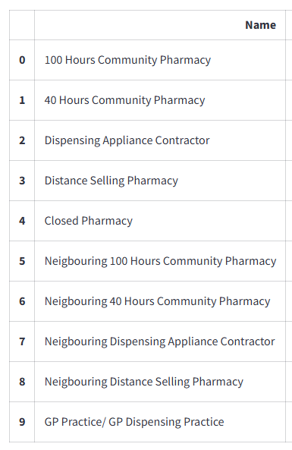
Introduction
Dorset East PNA Locality has no gaps and is in Dorset Council. It is largely rural with a higher proportion of older people compared to the national average. The local area has lower levels of deprivation compared to both local and national levels with no LSOAs amongst the 20% most deprived. Housing growth will be seen predominantly in West Parley as well as Wimborne Minster provided these developments are completed.
An analysis of health and the wider determinants of health highlights poor outcomes for cancer, coronary heart disease, heart failure, atrial fibrillation, stroke, hypertension, asthma, incidence of breast cancer and prostate cancer, hospital stays for self-harm and self-reported limiting long-term illness.
There are currently 16 pharmacies and one dispensing practice with one branches as of January 2025. The following headings have been used to describe the local area in more detail:
Number of pharmacies, openings hours & services
Demographics
Housing
Deprivation
Health and Wider Determinants

Slide 3
Number of Pharmacies
As of January 2025, there are 16 pharmacies in East PNA locality. There is one practice with one branch of practices with dispensing doctors providing drugs and appliances to their own patients.
Of the 16 pharmacies, there are:
14 providing Pharmacy First services.
13 independent pharmacies.
Three pharmacies owned by national pharmacy chains:
Two by Boots Pharmacy
One by Morrisons Pharmacy
15 pharmacies with 40-hour contracts and one pharmacy with 72-hour contracts. The 72-hour pharmacy is
Ferndown Pharmacy, 487 Ringwood Road, Ferndown.
One distance-selling pharmacy
No pharmacies with local pharmaceutical services contracts
One dispensing appliance contractor (DAC).

Slide 4
Number of Pharmacies
The table below shows the provision in Dorset East PNA locality since the last PNA was published. There is no national expectation or standard on the ratio of pharmacies to population. These ratios do not consider the size and staffing of pharmacies which will determine the size of the population they are able to serve.
Number and rate of pharmacies and items dispensed in Dorset East PNA Locality, 2021/22 - 2024/25 (8 months).
Financial Year | Area | Population | Number of pharmacies in latest month of FY | Pharmacies per 100,000 population | Number of dispensed items | Items dispensed per head
2021/22 | Locality | 89,222 | 17 | 19.1 | 1,780,681 | 20.0
2022/23 | Locality | 90,094 | 17 | 18.9 | 1,724,463 | 19.1
2023/24 | Locality | 90,094 | 16 | 17.8 | 1,768,224 | 19.6
2024/25 (8 months) | Locality | - | 17 | - | 1,186,556 | -
2023/24 | Dorset | 384,809 | 68 | 17.7 | 7,227,720 | 18.8
2023/24 | South West | 5,811,259 | 1,107 | 19.0 | 99,164,702 | 17.1
2023/24 | England | 57,690,323 | 12,009 | 20.8 | 1,112,920,890 | 19.3
Source: NHS Business Services Authority
Notes: Populations for locality and local authority are based on ONS mid-year population estimates. The population for each financial year is taken as the mid-year estimate for the first of the two years that make up the financial year. For example, for 2021/22 the population is taken as the mid-year estimate for 2021. If that year is not yet available, the latest available year is used.

Slide 5
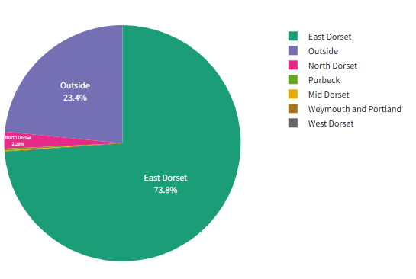
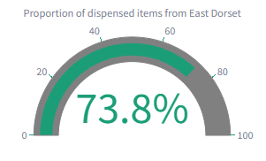
Number of Items Dispensed
The total number of items dispensed in this locality so far in 2024/25 is 1,186,556. Of the total number of items dispensed in this locality, 74% were prescriptions from GPs located in the same locality.

Slide 6
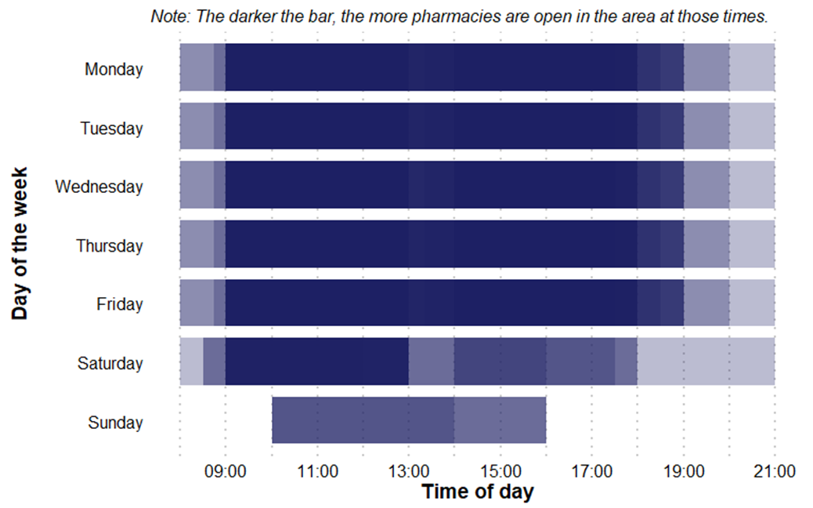
Pharmacy Opening Times
Dorset East PNA Locality pharmacy coverage across the week, January 2025
Access to the essential services (core plus supplementary opening hours)
As of January 2025, in East PNA locality, there are:
Four pharmacies open seven days a week
Eight pharmacies open six days a week
Four pharmacies open five days a week
No pharmacies open before 8:00 at least five days a week
Six pharmacies open past 18:30 at least five days a week

Slide 7
Provision of Services
Below is a summary of the provision of advanced and enhanced services in Dorset East PNA locality as of January 2025.
New Medicine Service (NMS) accreditation: 15 pharmacies. In 2023/24 (the last full year of data), there were 6,195 NMSs undertaken.
Specialist Medicines Provider: No pharmacies.
Influenza vaccination: 12 pharmacies providing this advanced service.
Appliance Use Reviews: One pharmacy providing this service. Many appliances will be dispensed by DACs based around the country, which may provide this service.
NHS Pharmacy contraception: Eight pharmacies providing this service.
Lateral Flow Device test supply: 11 pharmacies providing this service.
Hypertension Case-Finding: 13 pharmacies providing this service.
Stop Smoking: 15 pharmacies providing this service.

Slide 8
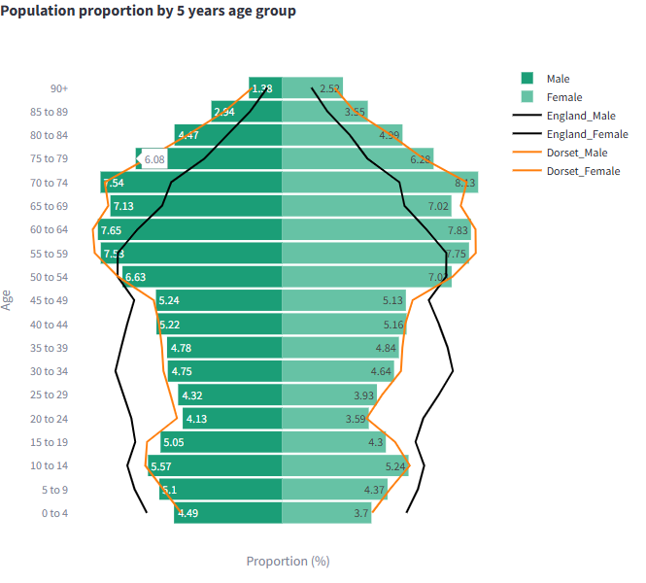
Demographics
Mid year resident population data show that there are approximately 90,100 people resident in the Dorset East PNA Locality (43,400 males and 46,700 females).
52% of its residents are female, 48% are male. 32% are 65 years and older.
Compared to the Dorset average, Dorset West has a lower proportion of people aged 15-24 and a higher proportion of people aged 65 & over.
Compared to the national average it has a lower proportion of people aged under 18 and of working age but a higher proportion of people aged 65 & over.
Source: Mid Year Population Estimates 2022

Slide 9
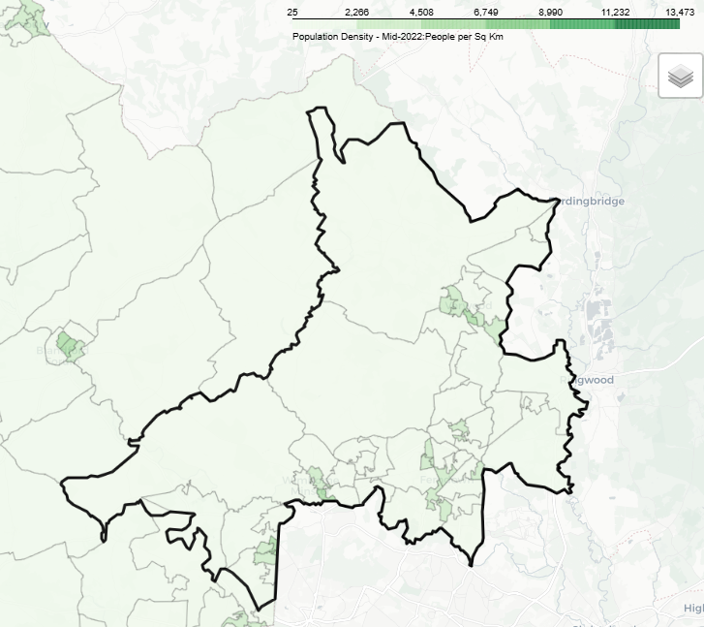
Demographics
The area covered by the local area is largely rural with the highest population density around the towns of Wimborne, Corfe Mullen, Ferndown and Verwood.
Over the next 3 years from 2025-28 population projections suggest the population of Dorset overall will increase by 4,300 (1.1%). This growth is driven by increases in the population aged over 65, with the number of children and young people (aged 0-16), and working age population projected to decrease.
The number of over 65s are projected to increase by almost 8,200 thousand (7%) to 2028, compared to a decrease of around 1,900 (-3%) for children and young people aged 0-16. The working age population is forecasts to decline by just under 2,000 (-1%). By 2025 those aged 65+ will account for a third of the overall population.

Slide 10
Demographics

Slide 11
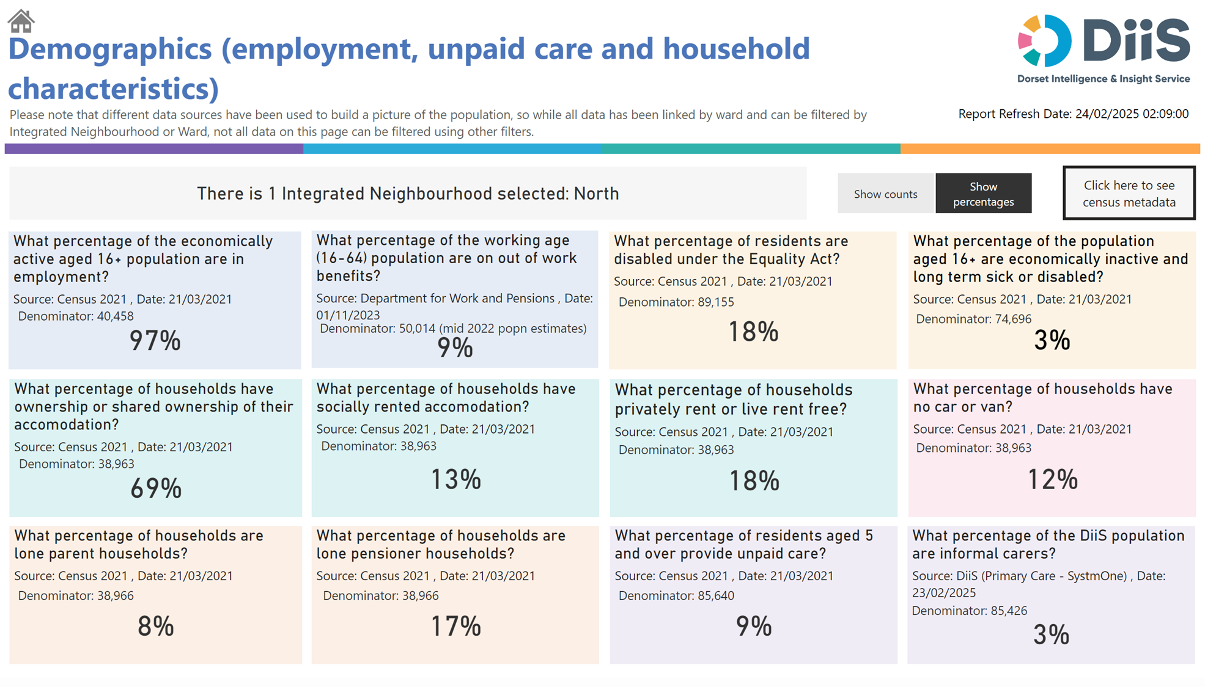
Demographics

Slide 12
Housing
To understand any increases in demand for services based on planned housing developments, planning applications with consent to build to 2029 in BCP and Dorset have been analysed. Postcodes (or the nearest existing postcode to the development site) have been matched to Wards and then to PNA Locality.
This gives a realistic picture of housing growth within the PNA locality. The net level of development for this PNA Locality is approximately 1,776 dwellings. This is about 20% of the total net housing development for Dorset Council.
Development looks to be predominantly towards the south of the PCN area, with significant development in West Parley (507), Colehill & Wimborne Minster East (424), Wimborne Minster (275) and Cranborne & Alderholt (143).

Slide 13
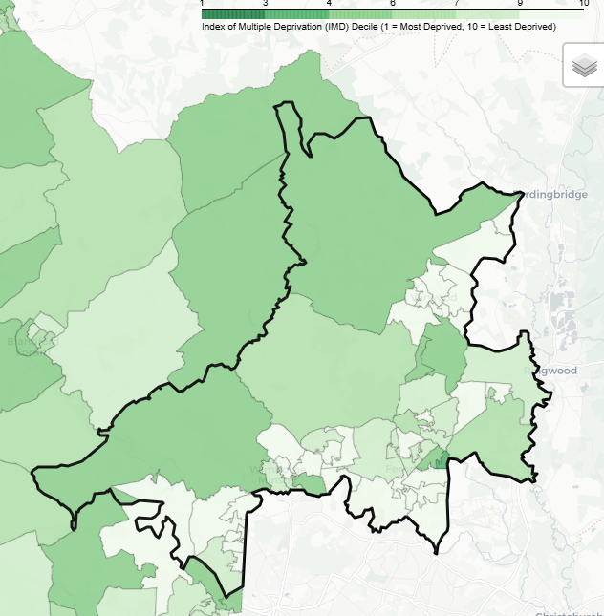
Deprivation
There are no lower super output areas (LSOAs) in Dorset East PNA Locality that are in the most deprived national quintile.
Five LSOAs are among the most 40% deprived.
9% of its population live in the 20% most deprived areas of Dorset.
None of its residents live in the 20% most deprived areas of England.

Slide 14
Health and Wider Determinants

Slide 15
Health and Wider Determinants

Slide 16
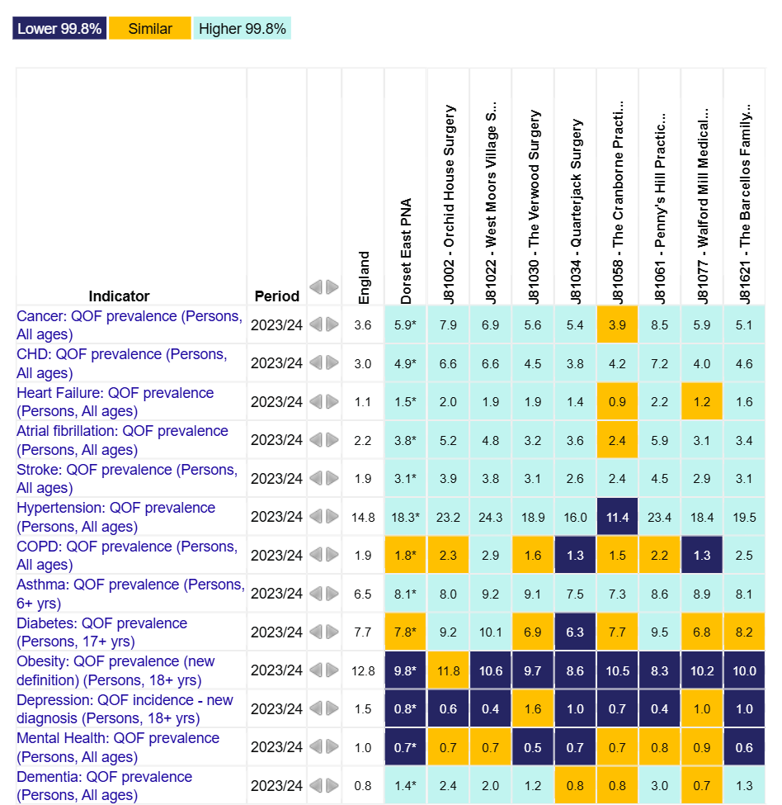
Health and Wider Determinants
To understand the health needs and wider determinants of health in the PNA Locality, a national profiling tool has been used. This compares local level data with the English average and highlights any areas that are significantly different.
The overview chart visualises the data and for each indicator it highlights whether the value is lower or higher to national rates using a 99.8% confidence interval.

