Slide 1
Pharmaceutical Needs Assessment:
Christchurch & Southbourne and Littledown
PNA Locality Profile
March 2025

Slide 2
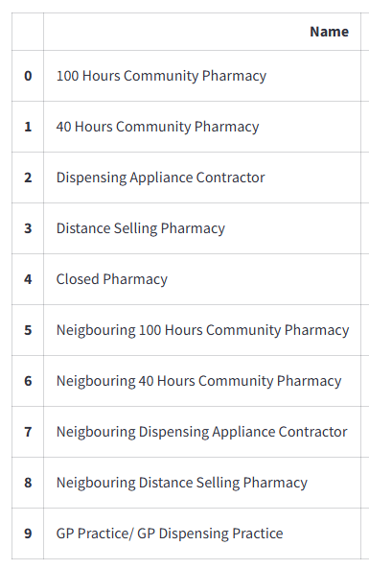

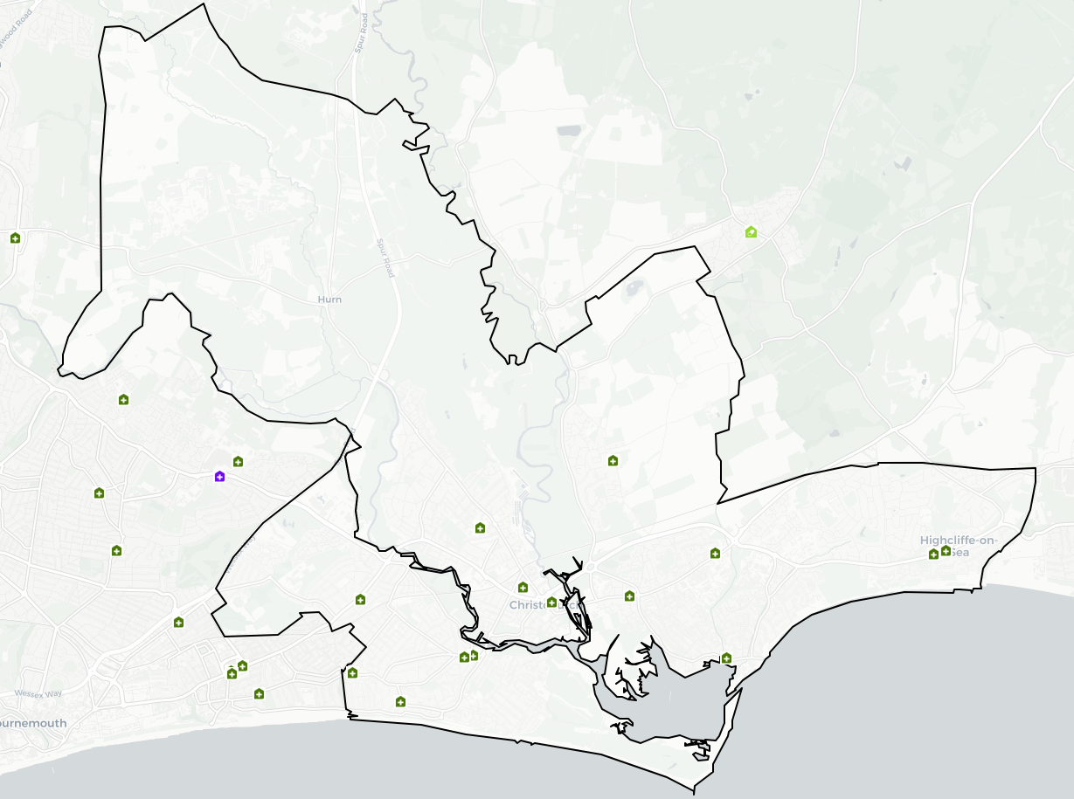
Introduction
Christchurch PNA locality has no gaps and is largely rural in area but surrounds an urban centre. The local area is in BCP Council. The proportion of older people in the local area is higher than the BCP and national average. There are three areas that are within the 20% most deprived in England.
Housing growth will be seen in Christchurch Town and Mudeford, Stanpit and West Highcliffe areas, provided these developments are completed.
An analysis of health and the wider determinants of health highlights higher levels of cancer, coronary heart disease, atrial fibrillation, stroke, hypertension and a greater proportion with caring responsibilities compared to England. There are currently 14 pharmacies as of January 2025.
The following headings have been used to describe the PNA locality in more detail:
Number of pharmacies, opening hours & services
Demographics
Housing
Deprivation
Health and Wider Determinants

Slide 3
Number of Pharmacies
As of January 2025, there are 14 pharmacies in Canford and Creekmoor Group & Christchurch Area Group PNA locality. There are no practices or branches of practices with dispensing doctors providing drugs and appliances to their own patients.
Of the 14 pharmacies, there are:
14 providing Pharmacy First services.
Seven independent pharmacies.
Seven pharmacies owned by national pharmacy chains:
  Three by Boots Pharmacy
  Two by Kamsons Pharmacy
  One by Day Lewis Pharmacy
  One by Rowlands Pharmacy
14 pharmacies with 40-hour contracts and no pharmacies with 72-hour contracts.
No distance-selling pharmacies
No pharmacies with local pharmaceutical services contracts
No dispensing appliance contractors (DAC).

Slide 4
Number of Pharmacies
The table below shows the provision in Christchurch & Southbourne and Littledown PNA locality since the last PNA was published. There is no national expectation or standard on the ratio of pharmacies to population. These ratios do not consider the size and staffing of pharmacies which will determine the size of the population they are able to serve.
Number and rate of pharmacies and items dispensed in Christchurch & Southbourne and Littledown PNA Locality, 2021/22 - 2024/25 (8 months).
Financial Year | Area | Population | Number of pharmacies in latest month of FY | Pharmacies per 100,000 population | Number of dispensed items | Items dispensed per head
2021/22 | Locality | 79,575 | 16 | 20.1 | 1,714,353 | 21.5
2022/23 | Locality | 78,834 | 16 | 20.3 | 1,746,544 | 22.2
2023/24 | Locality | 78,834 | 15 | 19.0 | 1,776,035 | 22.5
2024/25 (8 months) | Locality | - | 14 | - | 1,196,308 | -
2023/24 | Bournemouth, Christchurch and Poole | - | 73 | - | 6,978,169 | -
2023/24 | South West | 5,811,259 | 1,107 | 19.0 | 99,164,702 | 17.1
2023/24 | England | 57,690,323 | 12,009 | 20.8 | 1,112,920,890 | 19.3
Source: NHS Business Services Authority
Notes: Populations for locality and local authority are based on ONS mid-year population estimates. The population for each financial year is taken as the mid-year estimate for the first of the two years that make up the financial year. For example, for 2021/22 the population is taken as the mid-year estimate for 2021. If that year is not yet available, the latest available year is used.

Slide 5
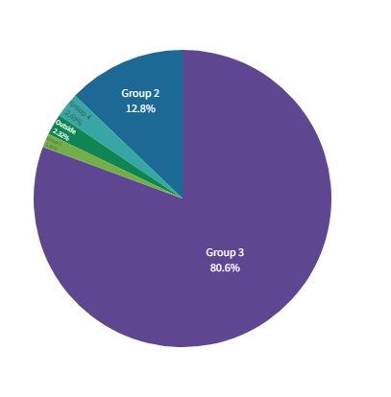
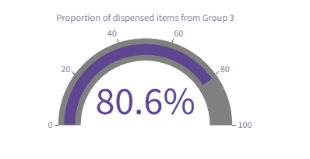
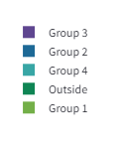
Number of Items Dispensed
The total number of items dispensed in this locality so far in 2024/25 is 1,196,308. Of the total number of items dispensed in this locality, 81% were prescriptions from GPs located in the same locality.

Slide 6
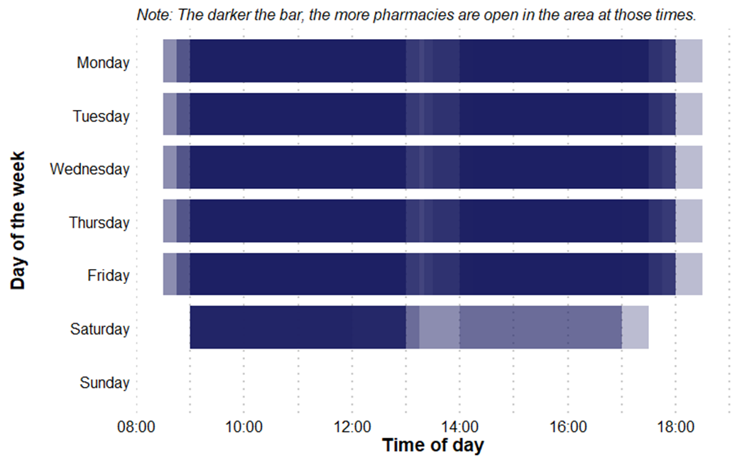
Pharmacy Opening Times
Christchurch & Southbourne and Littledown PNA Locality pharmacy coverage across the week, January 2025
Access to the essential services (core plus supplementary opening hours)
As of January 2025, in Christchurch & Southbourne and Littledown PNA locality, there are:
No pharmacies open seven days a week
10 pharmacies open six days a week
Four pharmacies open five days a week
No pharmacies open before 8:00 at least five days a week
No pharmacies open past 18:30 at least five days a week

Slide 7
Provision of Services
Below is a summary of the provision of advanced and enhanced services in Christchurch & Southbourne and Littledown PNA locality as of January 2025.
New Medicine Service (NMS) accreditation: 14 pharmacies. In 2023/24 (the last full year of data), there were 6,803 NMSs undertaken.
Specialist Medicines Provider: No pharmacies.
Influenza vaccination: 13 pharmacies providing this advanced service.
Stoma appliance customization: 1 pharmacy provides this service.
Appliance Use Reviews: No pharmacies providing this service. Many appliances will be dispensed by DACs based around the country, which may provide this service.
NHS Pharmacy contraception: 12 pharmacies providing this service.
Lateral Flow Device test supply: 10 pharmacies providing this service.
Hypertension Case-Finding: 14 pharmacies providing this service.
Stop Smoking: 14 pharmacies providing this service.

Slide 8
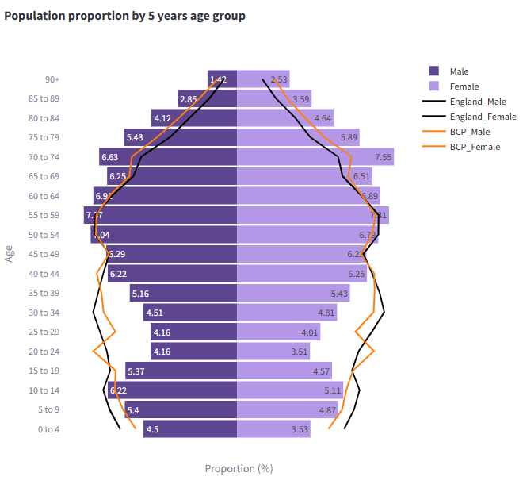
Demographics
Mid year resident population data show that there are approximately 79,000 people resident in this PNA Locality (37,600 males and 41,400 females).
52% of its residents are female, 48% are male. 30% are 65 years and older.
Compared to the Dorset average, the local area has a lower proportion of people aged under 45 and a higher proportion of people aged 65 & over.
Compared to the national average it has a lower proportion of people aged under 18 and of working age but a higher proportion of people aged 65 & over.
Source: Mid Year Population Estimates 2022

Slide 9
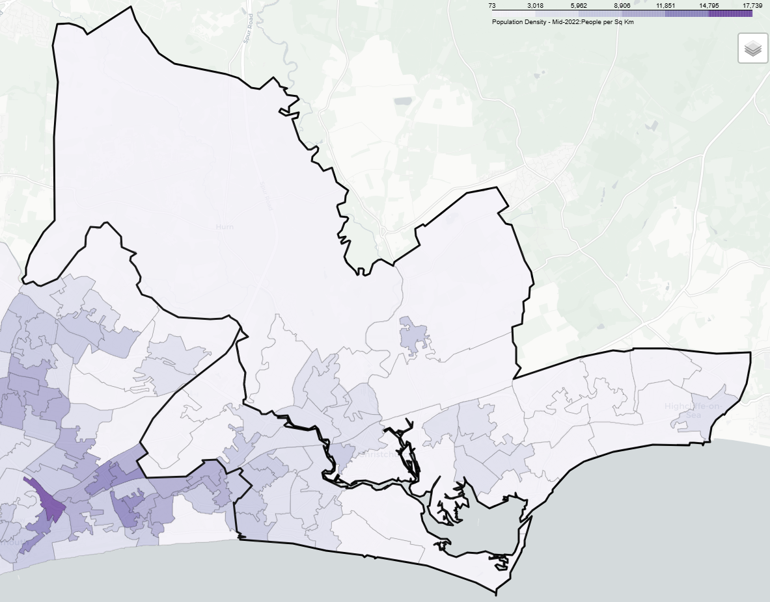
Demographics
The area covered by the PNA locality is largely rural with the highest population density near Pokesdown, Iford, Southbourne and Burton.
Over the next 3 years from 2025-28 population projections suggest the population of Dorset overall will increase by 4,300 (1.1%). This growth is driven by increases in the population aged over 65, with the number of children and young people (aged 0-16), and working age population projected to decrease.
The number of over 65s are projected to increase by almost 8,200 thousand (7%) to 2028, compared to a decrease of around 1,900 (-3%) for children and young people aged 0-16. The working age population is forecasts to decline by just under 2,000 (-1%). By 2025 those aged 65+ will account for a third of the overall population.

Slide 10
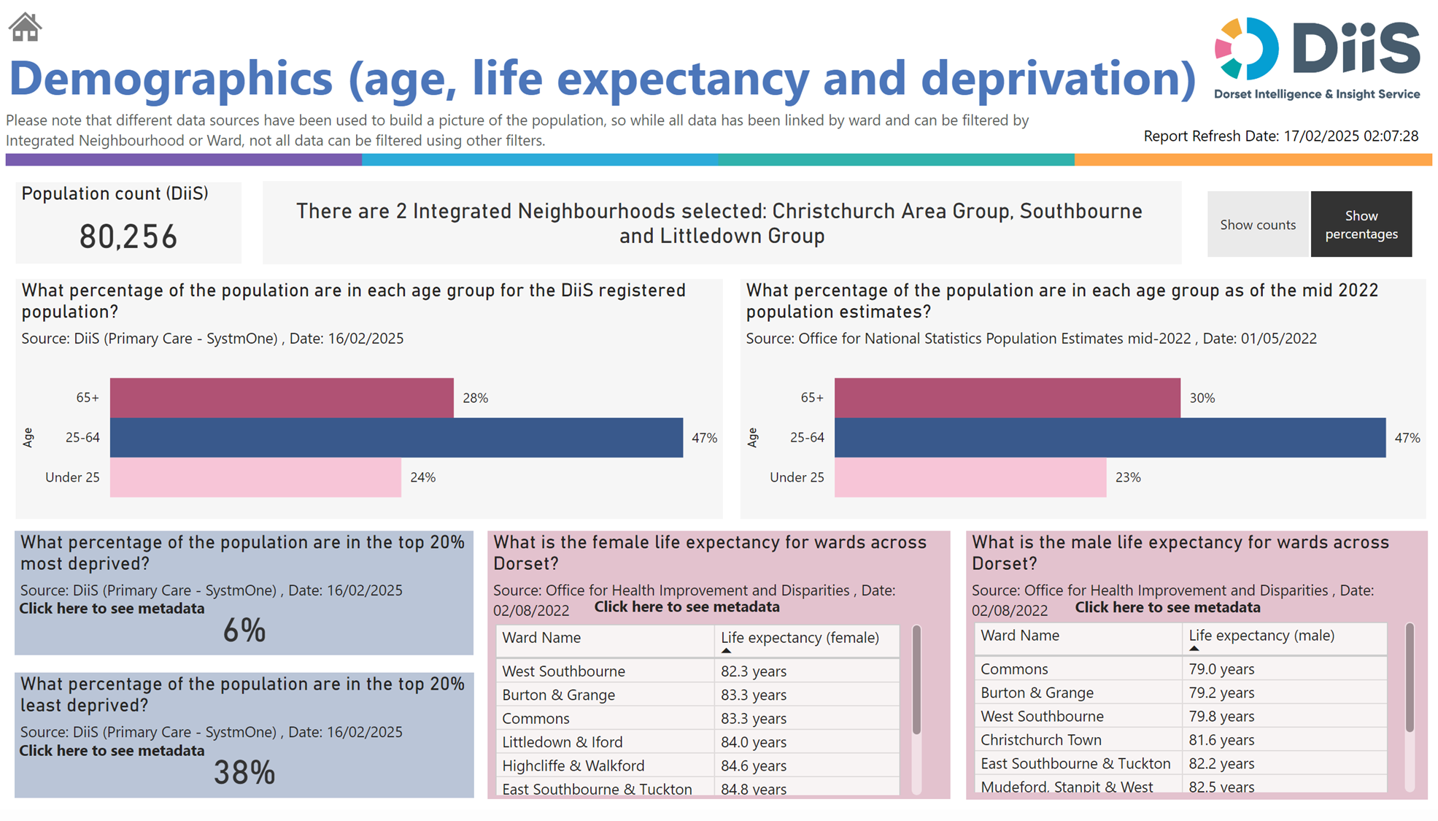
Demographics

Slide 11
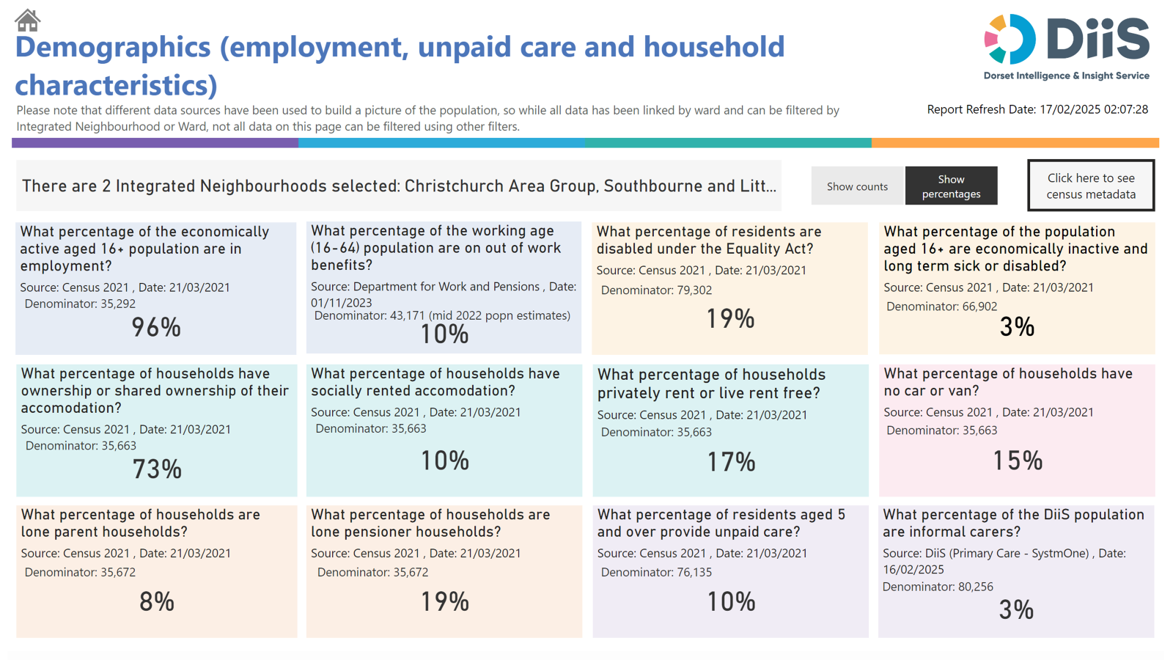
Demographics

Slide 12
Housing
To understand any increases in demand for services based on planned housing developments, planning applications with consent to build to 2029 in BCP and Dorset have been analysed. Postcodes (or the nearest existing postcode to the development site) have been matched to Wards and then to PNA Locality.
This gives a realistic picture of housing growth within the Neighbourhood. The net level of development for this PNA Locality is approximately 789 dwellings. This is about 10% of the total net housing development for BCP.
The main areas of proposed development in the PNA local area are in Christchurch Town Centre (199) and Mudeford, Stanpit and West Highcliffe (123).

Slide 13
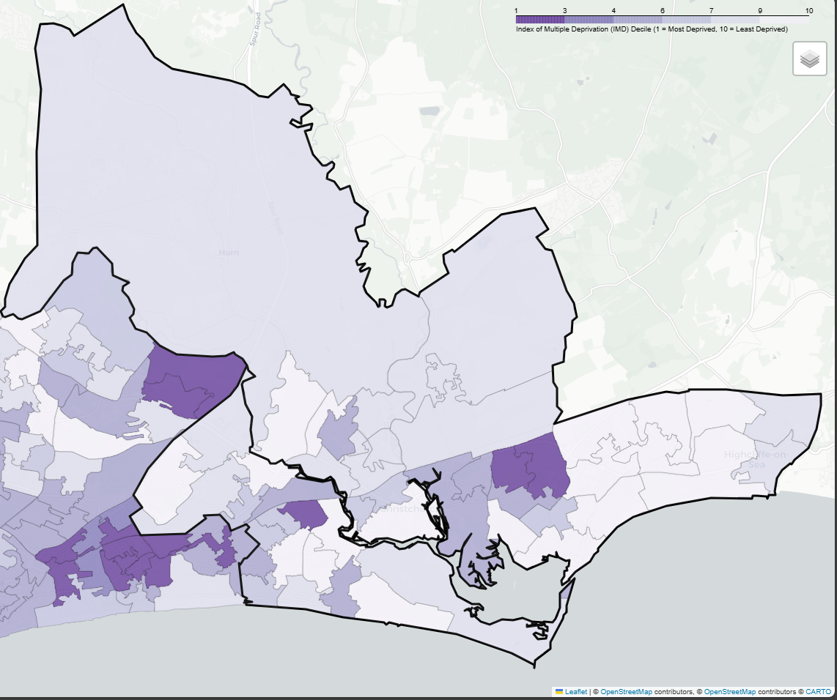
Deprivation
There are 3 lower super output areas (LSOAs) in this PNA Locality that are in the most deprived national quintile.
One LSOAs is are among the most 40% deprived.
6% of its population live in the 20% most deprived areas of Dorset.
6% of its residents live in the 20% most deprived areas of England.

Slide 14
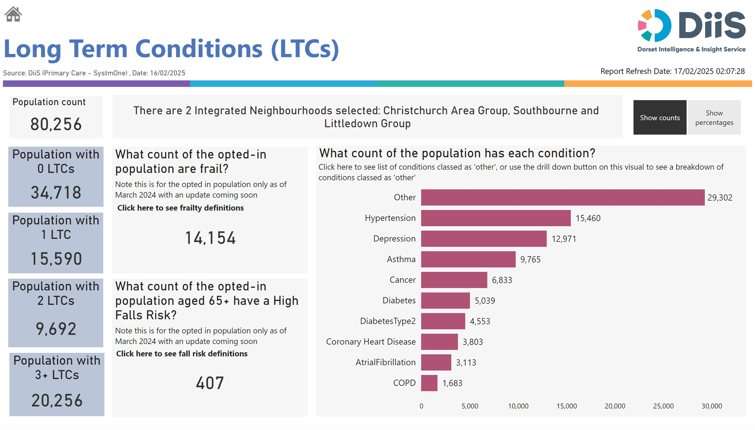
Health and Wider Determinants

Slide 15
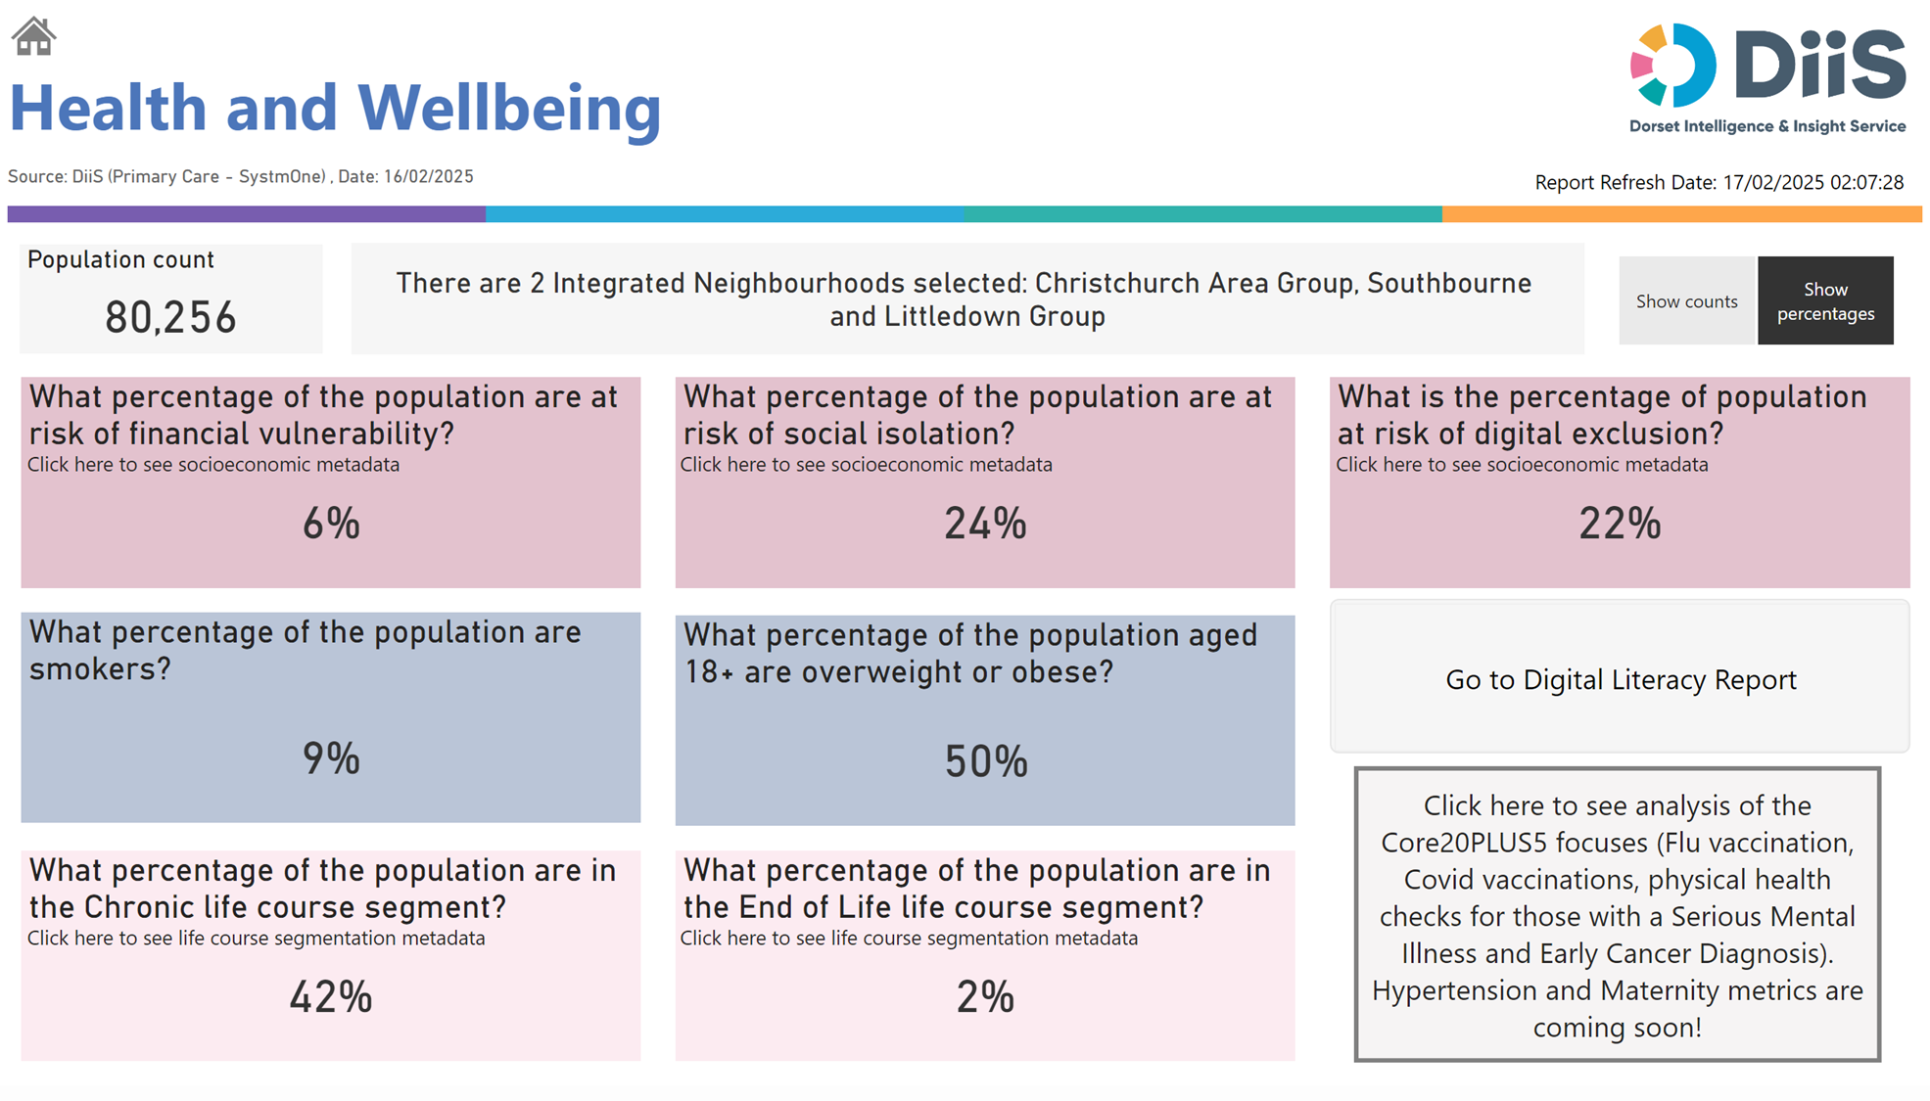
Health and Wider Determinants

Slide 16
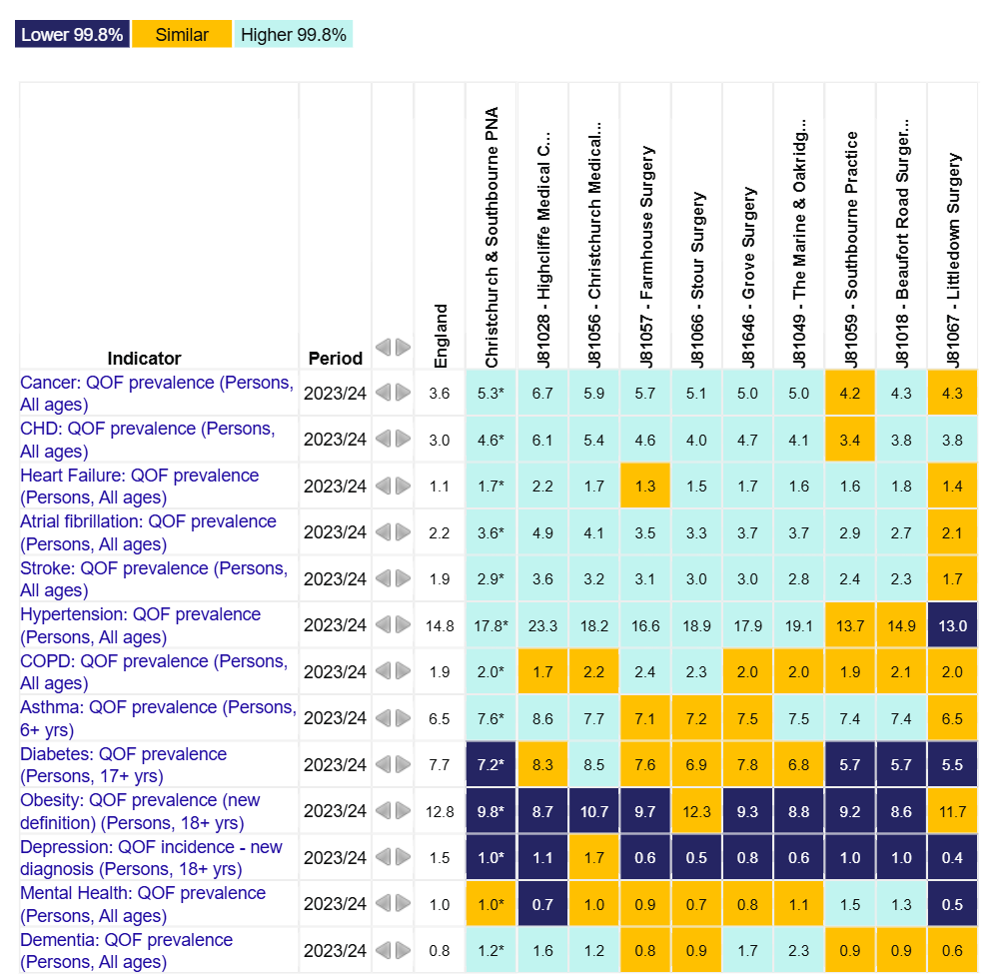
Health and Wider Determinants
To understand the health needs and wider determinants of health in the PNA Locality, a national profiling tool has been used. This compares local level data with the English average and highlights any areas that are significantly different.
The overview chart visualises the data and for each indicator it highlights whether the value is lower or higher to national rates using a 99.8% confidence interval.

Slide 17
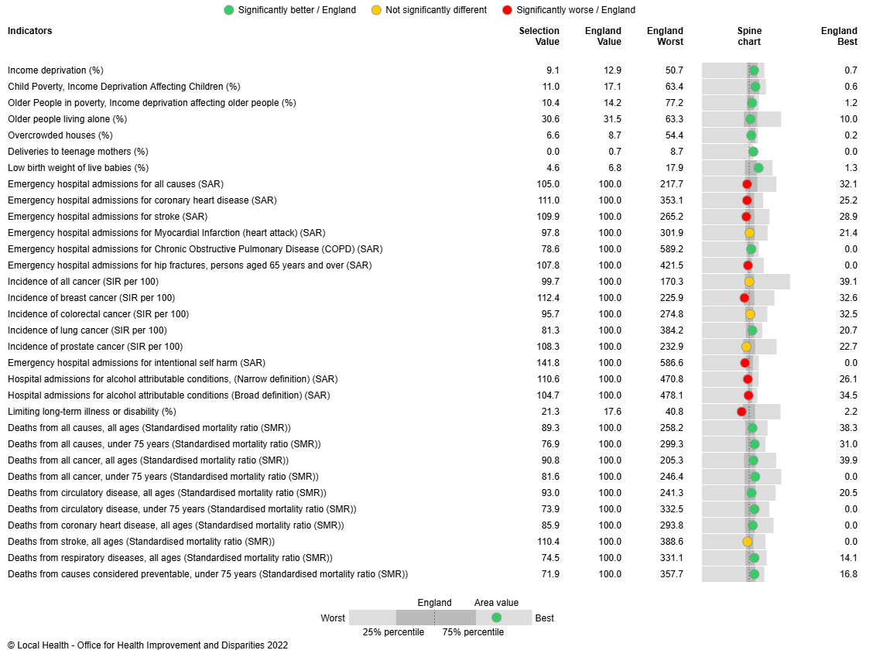
Health and Wider Determinants
Local Health provides evidence of inequalities within local areas aggregated to represent this PNA Locality.
The spine chart to the right visualises the data and for each indicator it highlights whether the value is significantly different to national rates using a 95% confidence interval.

