Slide 1
Pharmaceutical Needs Assessment: Boscombe & Poole East PNA Locality Profile
March 2025

Slide 2
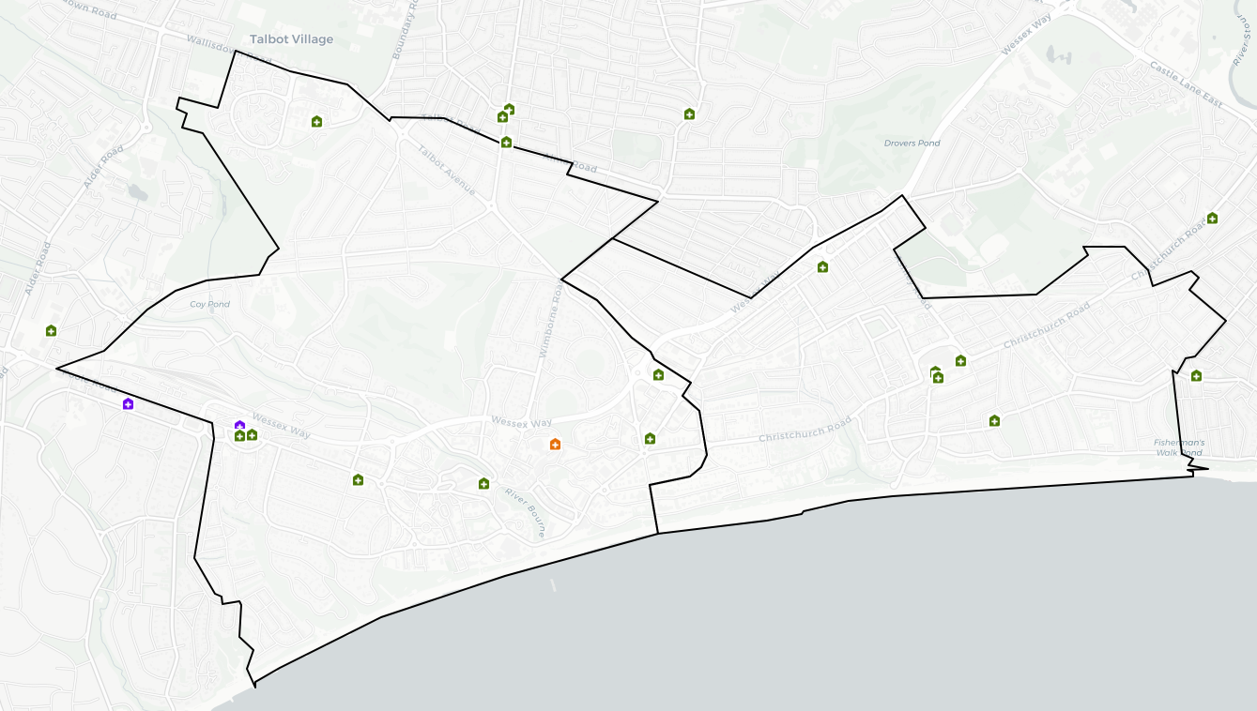
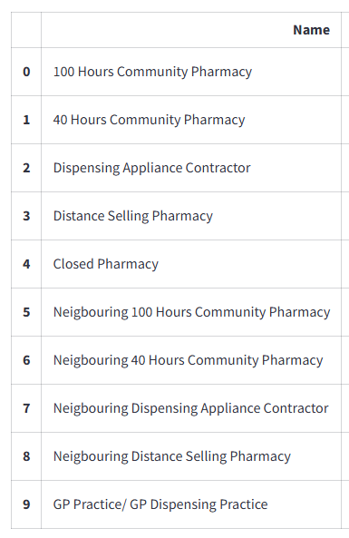
Introduction
Boscombe and Poole East has no gaps and is in BCP Council. It is largely urban and has higher levels of deprivation with 11 areas amongst the 20% most deprived in England. Housing growth will be seen predominantly in Bournemouth Central provided these developments are completed.
An analysis of health and the wider determinants of health highlights poor outcomes for income deprivation, child poverty, older people in poverty, overcrowded housing, emergency hospital admissions for coronary heart disease, stroke, heart attack, COPD and hip fractures, incidence of breast cancer, hospital stays for self-harm, alcohol related harm, deaths from causes considered preventable and self-reported limiting long term illness.
There are currently 15 pharmacies within the local area as of January 2025. The following headings have been used to describe the locality in more detail:
Number of pharmacies, openings hours & services
Demographics
Housing
Deprivation
Health and Wider Determinants

Slide 3
Number of Pharmacies
As of January 2025, there are 15 pharmacies in Boscombe Group & Poole East and Bournemouth Group PNA locality. There are no practices or branches of practices with dispensing doctors providing drugs and appliances to their own patients.
Of the 15 pharmacies, there are:
13 providing Pharmacy First services.
Seven independent pharmacies.
Eight pharmacies owned by national pharmacy chains:
Three by Boots Pharmacy
Two by Day Lewis Pharmacy
One by Asda Pharmacy
One by Kamsons Pharmacy
One by Superdrug Pharmacy
14 pharmacies with 40-hour contracts and one pharmacy with 72-hour contracts. The 72-hour pharmacy is
Poole Bay Pharmacy, Westbourne Medical Centre, Milburn Road, Westbourne, Bournemouth.
No distance-selling pharmacies
No pharmacies with local pharmaceutical services contracts
One dispensing appliance contractor (DAC).

Slide 4
Number of Pharmacies
The table below shows the provision in Boscombe & Poole East PNA locality since the last PNA was published. There is no national expectation or standard on the ratio of pharmacies to population. These ratios do not consider the size and staffing of pharmacies which will determine the size of the population they are able to serve.
Number and rate of pharmacies and items dispensed in Kinson and Wallisdown Group & Mid Bournemouth Group PNA Locality, 2021/22 - 2024/25 (8 months).
Financial Year | Area | Population | Number of pharmacies in latest month of FY | Pharmacies per 100,000 population | Number of dispensed items | Items dispensed per head
2021/22 | Locality | 84,021 | 16 | 19.0 | 1,205,518 | 14.3
2022/23 | Locality | 86,215 | 15 | 17.4 | 1,189,308 | 13.8
2023/24 | Locality | 86,215 | 15 | 17.4 | 1,178,781 | 13.7
2024/25 (8 months) | Locality | - | 15 | - | 788,047 | -
2023/24 | Bournemouth, Christchurch and Poole | - | 73 | - | 6,978,169 | -
2023/24 | South West | 5,811,259 | 1,107 | 19.0 | 99,164,702 | 17.1
2023/24 | England | 57,690,323 | 12,009 | 20.8 | 1,112,920,890 | 19.3
Source: NHS Business Services Authority
Notes: Populations for locality and local authority are based on ONS mid-year population estimates. The population for each financial year is taken as the mid-year estimate for the first of the two years that make up the financial year. For example, for 2021/22 the population is taken as the mid-year estimate for 2021. If that year is not yet available, the latest available year is used.

Slide 5
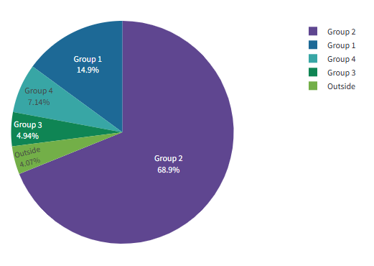
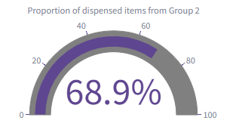
Number of Items Dispensed
The total number of items dispensed in this locality so far in 2024/25 is 788,047. Of the total number of items dispensed in this locality, 69% were prescriptions from GPs located in the same locality.

Slide 6
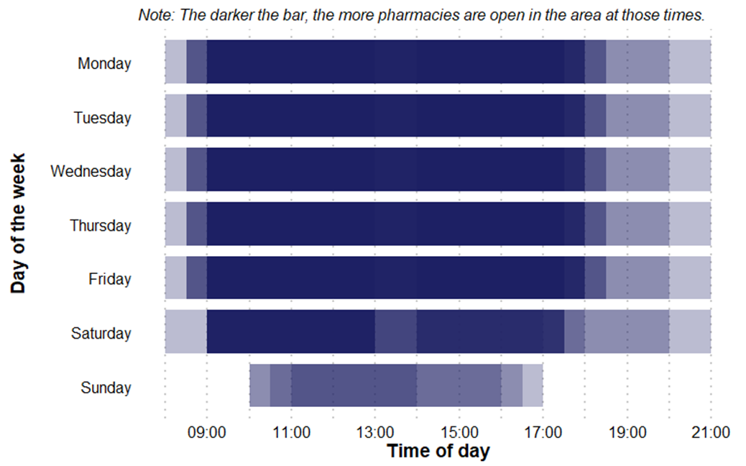
Pharmacy Opening Times
Boscombe & Poole East PNA Locality pharmacy coverage across the week, January 2025
Access to the essential services (core plus supplementary opening hours)
As of January 2025, in Boscombe Group & Poole East and Bournemouth Group PNA locality, there are:
Four pharmacies open seven days a week
Eight pharmacies open six days a week
Three pharmacies open five days a week
No pharmacies open before 8:00 at least five days a week
Two pharmacies open past 18:30 at least five days a week

Slide 7
Provision of Services
Below is a summary of the provision of advanced and enhanced services in Boscombe & Poole East and Bournemouth Group PNA locality as of January 2025.
New Medicine Service (NMS) accreditation: 14 pharmacies. In 2023/24 (the last full year of data), there were 3,719 NMSs undertaken.
Specialist Medicines Provider: No pharmacies.
Influenza vaccination: 12 pharmacies providing this advanced service.
Stoma appliance customisation: One pharmacy providing this service.
Appliance Use Reviews: One pharmacy providing this service. Many appliances will be dispensed by DACs based around the country, which may provide this service.
NHS Pharmacy contraception: 10 pharmacies providing this service.
Lateral Flow Device test supply: 10 pharmacies providing this service.
Hypertension Case-Finding: 11 pharmacies providing this service.
Stop Smoking: 14 pharmacies providing this service.

Slide 8
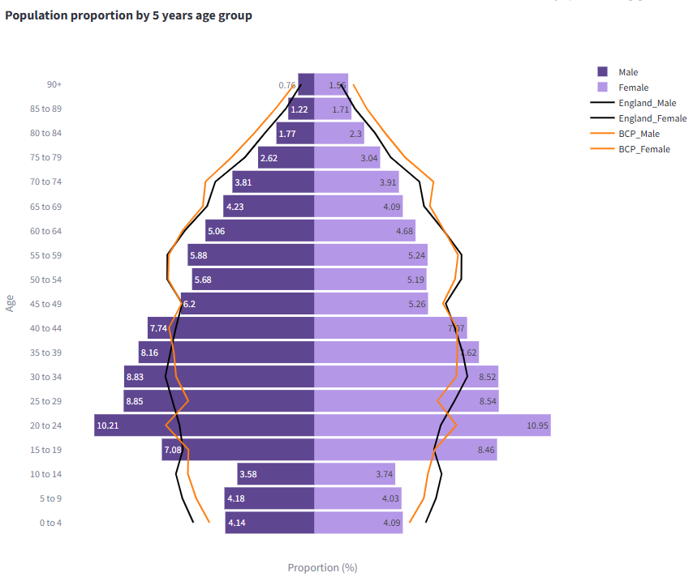
Demographics
Mid year resident population data show that there are approximately 81,200 people resident in the Mid-Bournemouth, Wallisdown and Kinson PNA Locality (41,100 males and 40,100 females).
49% of its residents are female, 51% are male. 16% are 65 years and older.
Compared to the BCP average, it has a lower proportion of people aged 15-44 and a lower proportion of people aged 65 & over.
Source: Mid Year Population Estimates 2022

Slide 9
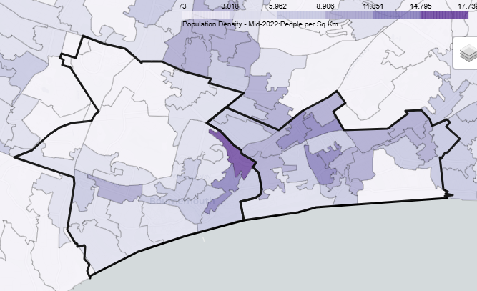
Demographics
The area covered by the PNA Locality is largely largely urban with the highest population density around Boscombe, Pokesdown, Springbourne and Lansdowne.
Over the next 3 years from 2025-28 projections suggest the population of the BCP area overall will increase by 2.6 thousand (0.7%).
This growth is driven by increases in the population aged over 65, with the number of children and young people (aged 0-16) projected to decrease.
The number of over 65s is projected to increase by almost 5.2 thousand (6%) to 2025, compared to a decrease of around 2.6 thousand of children and young people. The working age population is forecast to remain roughly unchanged. By 2025 those aged 65+ will account for 24% of the overall population.

Slide 10
Demographics

Slide 11
Demographics

Slide 12
Housing
To understand any increases in demand for services based on planned housing developments, planning applications with consent to build to 2029 in BCP and Dorset have been analysed. Postcodes (or the nearest existing postcode to the development site) have been matched to Wards and then to PNA Locality.
This gives a realistic picture of housing growth within the Neighbourhood. The net level of development for this PNA Locality is approximately 2,109 dwellings. This is about 44% of the total net housing development for BCP.
In this PNA locality the development will predominantly be seen in the Bournemouth Central area (1,701) particularly Holdenhurst Road and Exeter Road. There is also notable development in Westbourne & West Cliff (298) especially around Princess Road & Prince of Wales Road.

Slide 13
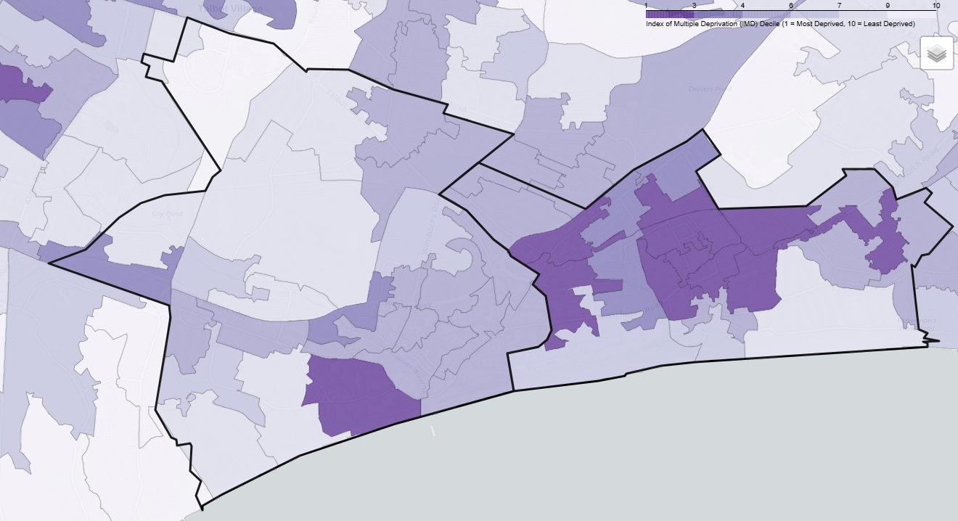
Deprivation
There are 11 lower super output areas (LSOAs) in this PNA Locality that are in the most deprived national quintile.
The highest levels of deprivation are found around Townsend, Boscombe, East Cliff & Springbourne and around Central Bournemouth.
A further 18 LSOAs are amongst the worst 40% deprived.
37% of its population live in the 20% most deprived areas of Dorset.
25% of its residents live in the 20% most deprived areas of England.

Slide 14
Health and Wider Determinants

Slide 15
Health and Wider Determinants

Slide 16
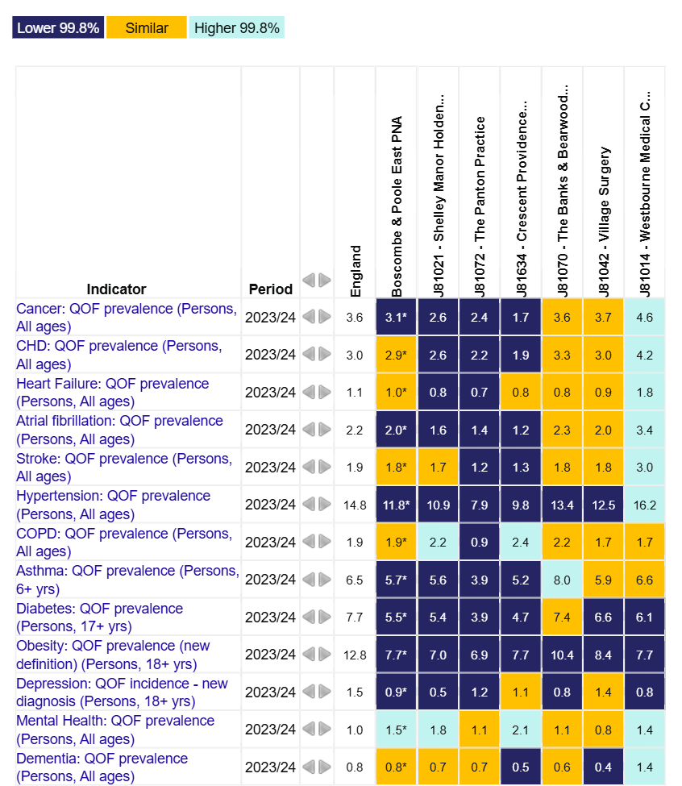
Health and Wider Determinants
To understand the health needs and wider determinants of health in the PNA Locality, a national profiling tool has been used. This compares local level data with the English average and highlights any areas that are significantly different.
The overview chart visualises the data and for each indicator it highlights whether the value is lower or higher to national rates using a 99.8% confidence interval.

Slide 17
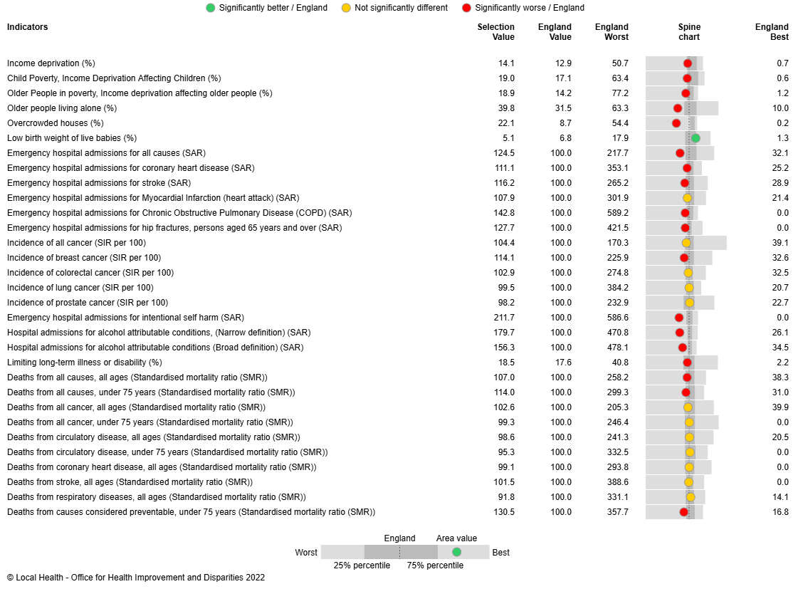
Health and Wider Determinants
Local Health provides evidence of inequalities within local areas aggregated to represent this PNA Locality.
The spine chart to the right visualises the data and for each indicator it highlights whether the value is significantly different to national rates using a 95% confidence interval.

